Slide 1
COMPSCI X433.6 Introduction to Machine Learning using Python
Lecture 1: What is machine learning?
Lecture 2: Is the Gaussian probability density function boring?
Lecture 3: Principal Component Analysis
Lecture 4: Principal Component Analysis (more details)
Lecture 5: Linear Classifiers
Lecture 6: Decision Trees
Lecture 7: Data Mining
Lecture 8: Neural Networks
Lecture 9: Ensemble Classifiers / Context-Dependent Classification
Lecture 10: Team Project Presentations

Slide 2
Lecture 1: What is machine learning?
What will you accomplish today ?
Glimpse of a real-life machine learning example from the banking industry
Excuse to introduce some jargon
Working definition: Oh… So, this is machine learning?
Working definition: Then what is Data Mining?
Machine Learning versus Other Things
Meet your first (ridiculously simple) classifier
An abstract look at the first classifier. How does it work?
Practical Motivation: An example from biometrics
Histograms.
Relevance of histograms for classification
“Regular” Histogram of teachers’ height
Normalized Histogram of teachers’ height
“Regular” Histogram of engineers’ height
Normalized Histogram of engineers’ height
More and more bins. Good or bad?
More and more bins. More and more samples.
Normalized Histograms to PDFs
Mean, median, standard deviation … Boring statistics
Mean, median, standard deviation … Boring statistics
The Cardinal Sinner
The Reformed
Histograms, PDFs and probabilities
Bayes Classifier (also, Theorem)
Bayes Classifier (also, Theorem)
Multi-class, multidimensional generalizations
Step-by-Step: Pseudocode for computing the histogram
Step-by-Step: Homework Assignment 1 (unofficial, always refer to the course website)
Step-by-Step: Homework Assignment 1
Schedule of Assignments

Slide 3
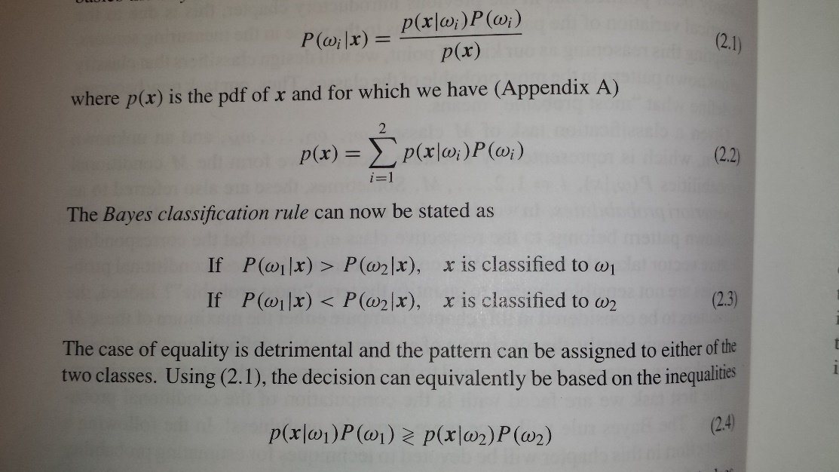
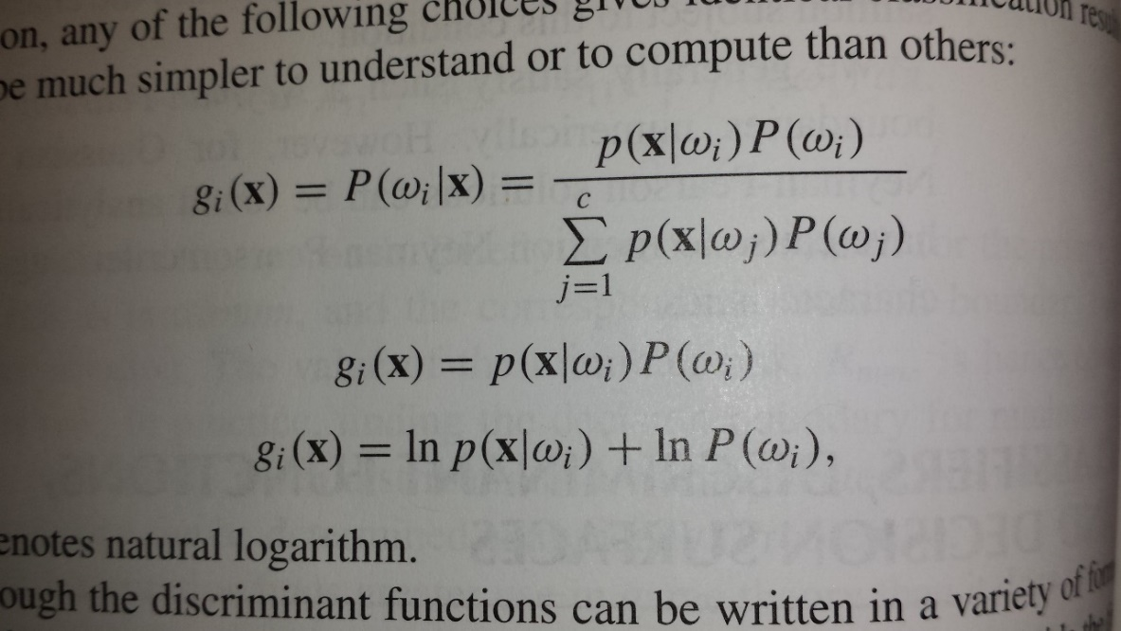
What will you accomplish today ?
Right after your very first class, go home with the knowledge to program two classifiers!
Know how to build multidimensional, multiclass classifiers! Yes. That is a stretch, but is essentially correct.
Look at this slide again after Lecture 1

Slide 4
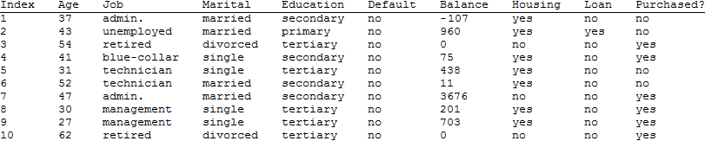
Glimpse of a real-life machine learning example from the banking industry
The machine learning problem
Alice works in a bank that actively sells loans.
She needs to meet her daily sales quota.
She has basic information on Bob, including his phone number.
She is worried that she will have to spend 30 minutes talking to Bob with no guarantee of closing any deal.
Should she call Bob, or move on to the next potential customer?
A possible solution
Look at records of similar individuals and check if a successful sale was made.
A look at some of the data (partial)
S. Moro, R. Laureano and P. Cortez. Using Data Mining for Bank Direct Marketing: An Application of the CRISP-DM Methodology. In P. Novais et al. (Eds.), Proceedings of the European Simulation and Modelling Conference - ESM'2011, pp. 117-121, Guimarães, Portugal, October, 2011. EUROSIS.
A new candidate's financial variables must be compared against entries in a huge database and a prediction must be computed.

Slide 5
Excuse to introduce some jargon
Training Set
Ordinal
Nominal
Nominal
Nominal
Nominal
Ordinal
Nominal
Nominal
Class label
Features
Feature Vector
also called pattern

Slide 6


Working definition: Oh… So, this is machine learning?
Classifier Usage
Classifier
Feature Vector
Output Class Label
Classifier Design
Learning Algorithm
Training set
Classifier
(Feature Vectors+
Known Class Labels)
Eric Graham, you have been honored with the Eagle Eye Award for spotting an error or omission on this slide.
Congratulations and thank you for your help in improving this presentation.
CLICK TO DISMISS
This is also known as supervised learning (learning from examples)
*These definitions cover most, but not all of machine learning

Slide 7
Working definition: Then what is Data Mining?
Classifier Usage
Classifier
Groupings or
Clusters of
patterns
Input patterns
This is also known as unsupervised learning (learning without examples)
*Data Mining is part of machine learning

Slide 8
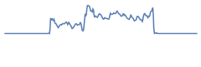
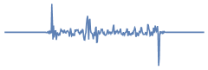

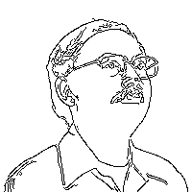
Machine Learning versus Other Things
DSP
(Digital Signal Processing)
DIP
(Digital Image Processing)

Slide 9
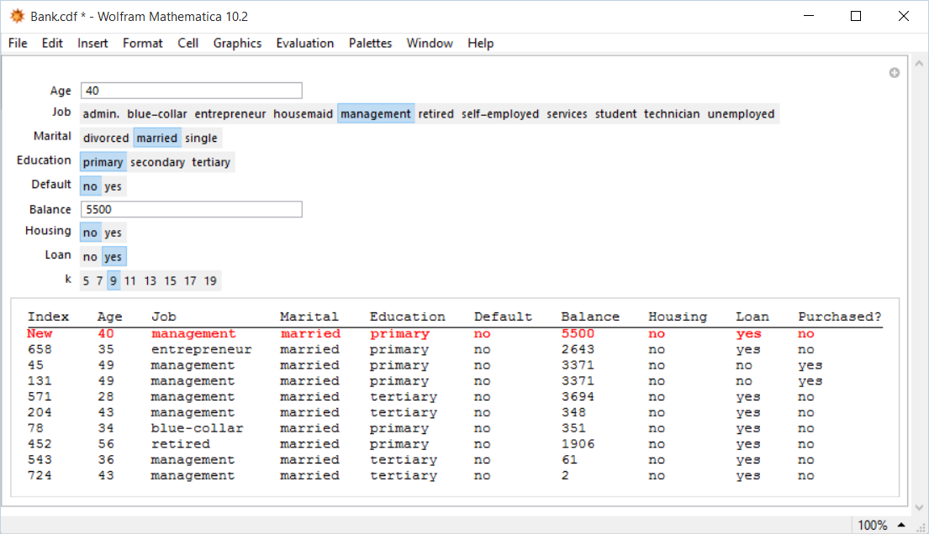
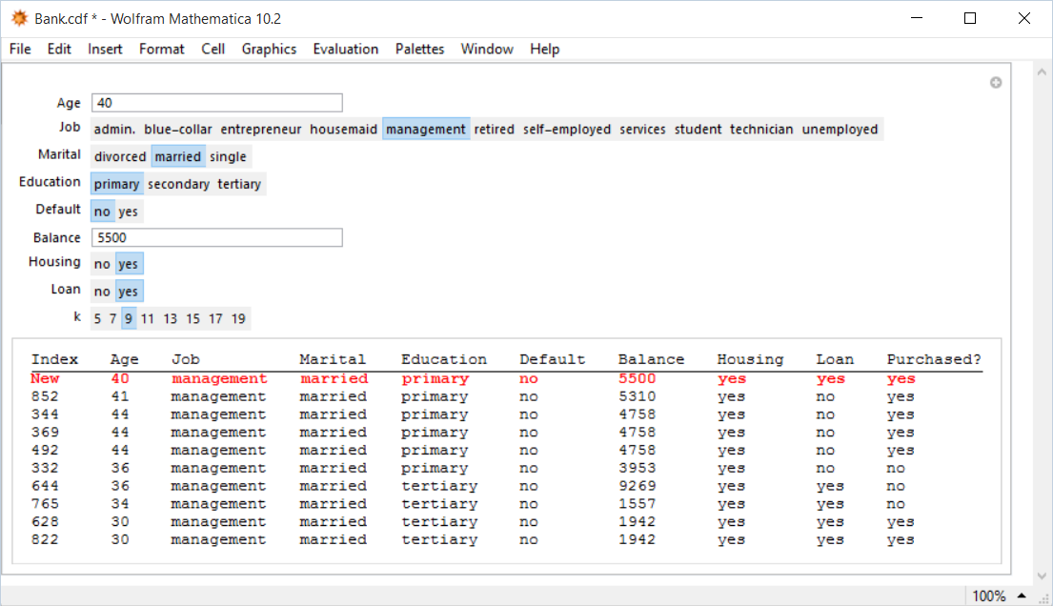
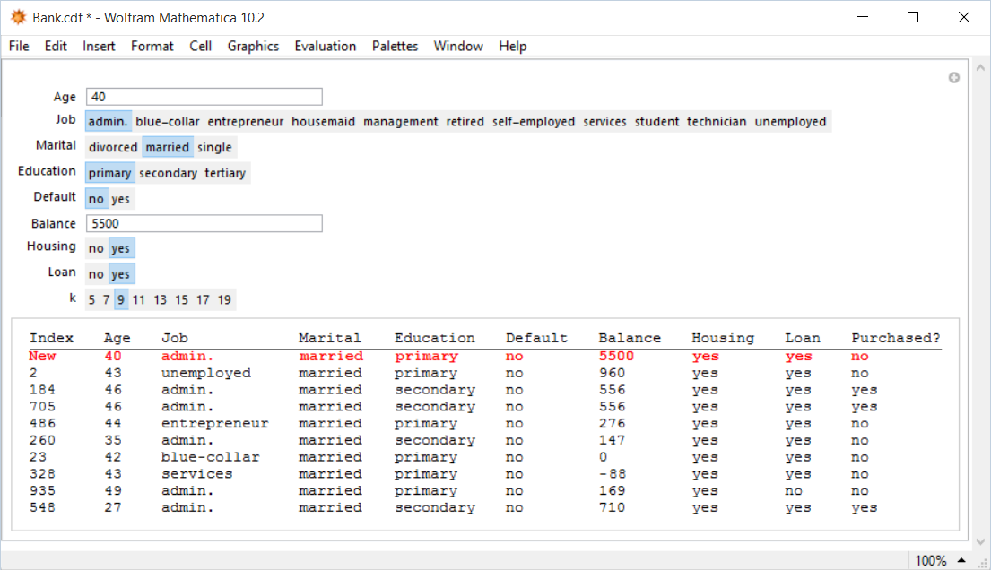
Meet your first (ridiculously simple) classifier
Query
Prediction
The algorithm retrieves feature vectors similar to the query vector

Slide 10
An abstract look at the first classifier. How does it work?
User inputs a correctly formed feature vector. [User “queries.”]
The algorithm searches the training set and retrieves the subset of 9 feature vectors closest to the input feature vector.
The algorithm assigns the class label of the input feature vector to the commonest of the class labels associated with the feature vectors of the subset.
For now, we will not worry about how steps 1, 2 & 3 are translated to working code.
This method, widely used in practice, is called the k-Nearest Neighbor Classifier, or k-NN.

Slide 11
Practical Motivation: An example from biometrics
An airport scanner records a person’s height as 67 inches. Is the person male or female?
Question: How do we go about answering such a question?
Answer: Gather a large number of 67 inch individuals from the general population.
Count the number of males $(M$) and females $(F$)
Posit that the queried individual is male if $M>F$, or female if $F>M$
Refinement (Data Science): The probability that the queried individual is male is $\frac{M}{M+F}$
Follow-up Question: Can we design a classifier to “recognize” the gender given the height? How do we represent data showing the heights of males and females in a general population?
Note: This is not merely a textbook exercise. Biometric systems used in security and authentication actually use the concepts described here.

Slide 12
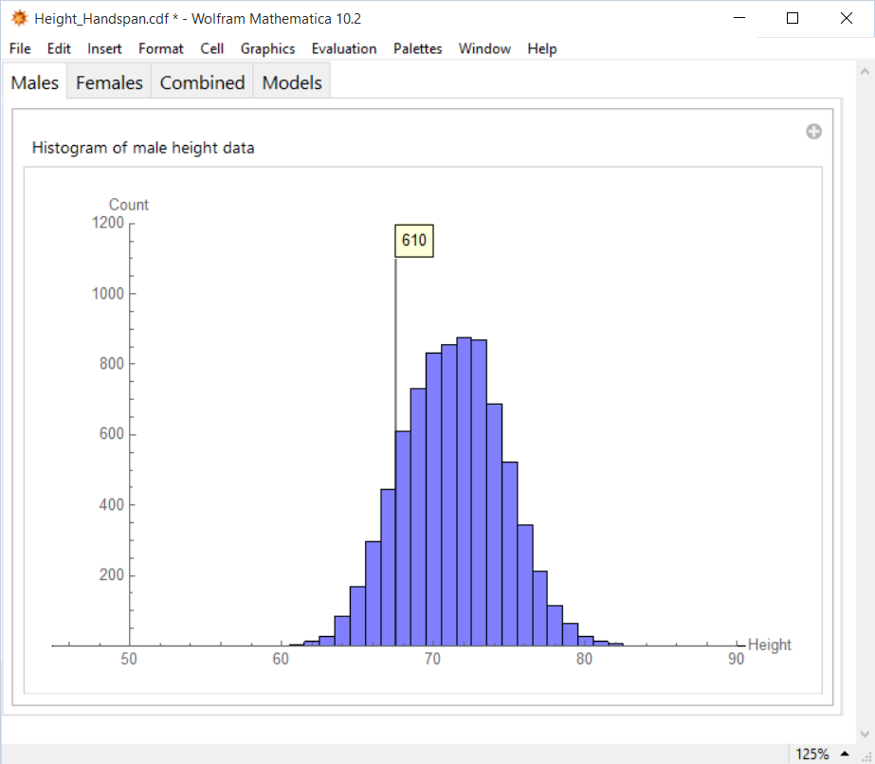
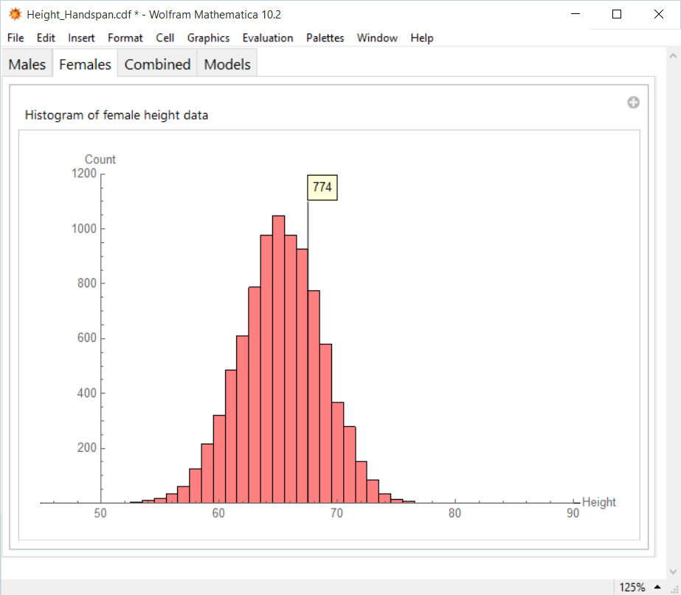
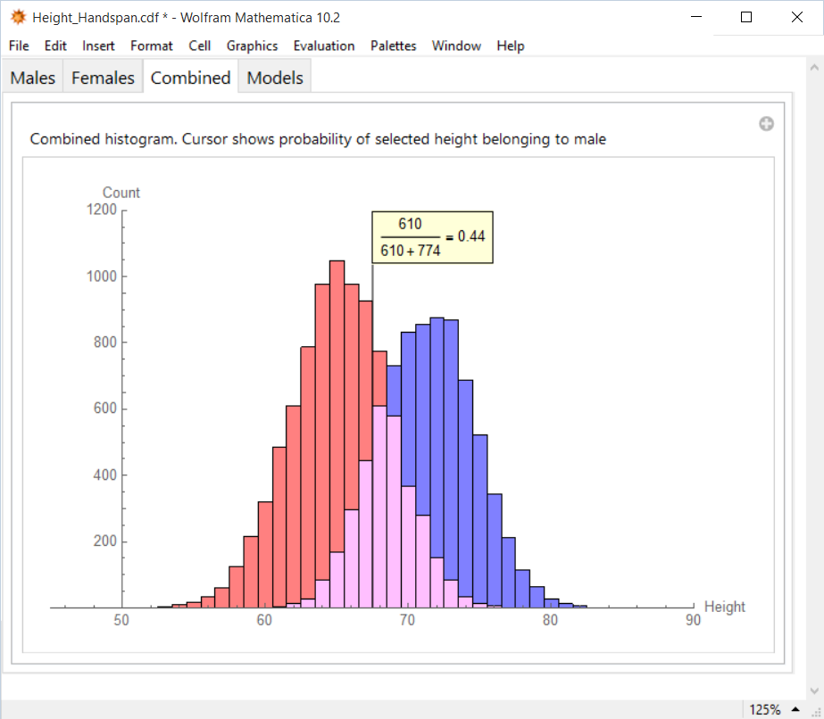
Histograms.
What is the probability of a 67 inch person being male?
How many 67 inch males?
How many 67 inch females?
*To be rigorous, this question should read like “What is the count of females having height between 65 and 68 inches?” Same goes for other questions here.

Slide 13
Relevance of histograms for classification
Let us say you program functions $H_{M}\left(h\right)$ and $H_{F}\left(h\right)$ that return the count of males and females for a given input height $h$ (±$dh$)
The classifier to “recognize” the gender given the height can easily be programmed as
IF $H_{M}\left(h\right)$ > $H_{F}\left(h\right)$ OUTPUT “M”
ELSE OUTPUT “F”
Or to put this in proper machine learning notation:
This boils down to answering the really simple question “Are there more males than females of height $h$?”
Effectively we have implemented
Search and retrieval of training feature vectors similar to the input feature vector
Assignment of class to the commonest of the class labels.
M
$$H_{M}\left(h\right)$$
>
$$H_{F}\left(h\right)$$
<
F

Slide 14
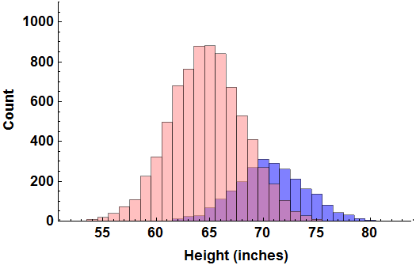
“Regular” Histogram of teachers’ height
672 Female teachers
with height 67”
151 Male teachers
with height 67”
If we are asked to guess the gender of a new 67” teacher, we would refer to the above regular histogram and decide the gender based on the following two computed probabilities:
Probability of being female, given h=67”
Probability of being male, given h=67”
$$=\frac{672}{151+672}=0.82$$
$$=\frac{151}{151+672}=0.18$$
$$=p(F|67")$$
$$=p(M|67")$$

Slide 15
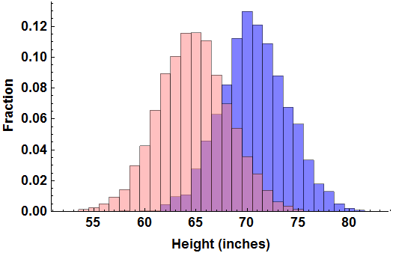
Normalized Histogram of teachers’ height
0.08842 Fraction of female teachers with height 67”
$$=p(67"|F)$$
0.06291 Fraction of male teachers with height 67”
7600 Female
teachers
$$=p(67"|M)$$
2400 Male
teachers
If we are asked to guess the gender of a new 67” teacher, we would refer to the above normalized histogram AND the additional information on prevalence and decide the gender based on the following two computed probabilities:
Probability of being female, given h=67”
Probability of being male, given h=67”
$$=\frac{P(F)×p(67"|F)}{P(F)×p(67"|F)+P(M)×p(67"|M)}$$
$$=\frac{7600×0.08842}{7600×0.08842+2400×0.06291}=0.82$$
$$=\frac{2400×0.06291}{7600×0.08842+2400×0.06291}=0.18$$
$$=p(F|67")$$
$$=p(M|67")$$
$$=\frac{P(M)×p(67"|M)}{P(F)×p(67"|F)+P(M)×p(67"|M)}$$

Slide 16
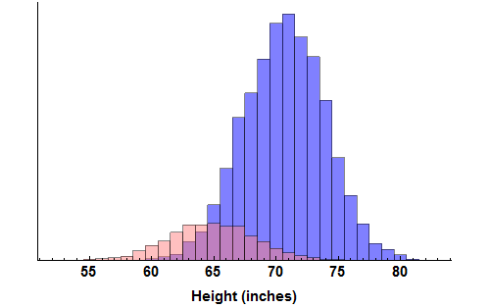
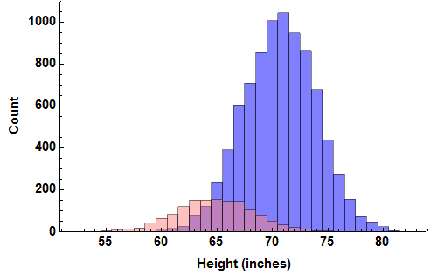
“Regular” Histogram of engineers’ height
144 Female engineers
with height 67”
605 Male engineers
with height 67”
If we are asked to guess the gender of a new 67” engineer, we would refer to the above regular histogram and compare the two probabilities:
Probability of being female, given h=67”
Probability of being male, given h=67”
$$=\frac{144}{144+605}=0.19$$
$$=\frac{605}{144+605}=0.81$$
$$=p(F|67")$$
$$=p(M|67")$$

Slide 17
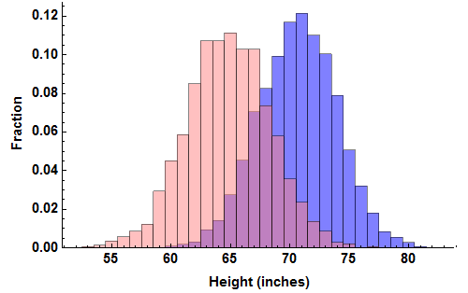
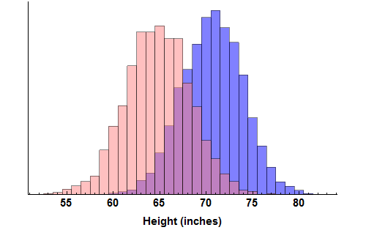
Normalized Histogram of engineers’ height
0.1028 Fraction of female engineers with height 67”
$$=p(67"|F)$$
0.0704 Fraction of male engineers with height 67”
1400 Female
engineers
$$=p(67"|M)$$
8600 Male
engineers
If we are asked to guess the gender of a new 67” engineer, we would refer to the above normalized histogram AND the additional information on prevalence and compare the two probabilities:
Probability of being female, given h=67”
Probability of being male, given h=67”
$$=\frac{P(F)×p(67"|F)}{P(F)×p(67"|F)+P(M)×p(67"|M)}$$
$$=\frac{1400×0.1028}{1400×0.1028+8600×0.0704}=0.19$$
$$=\frac{8600×0.0704}{1400×0.1028+8600×0.0704}=0.81$$
$$=p(F|67")$$
$$=p(M|67")$$
$$=\frac{P(M)×p(67"|M)}{P(F)×p(67"|F)+P(M)×p(67"|M)}$$

Slide 18
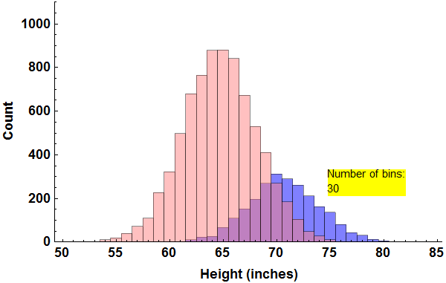
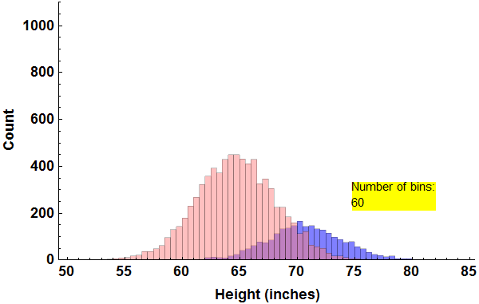
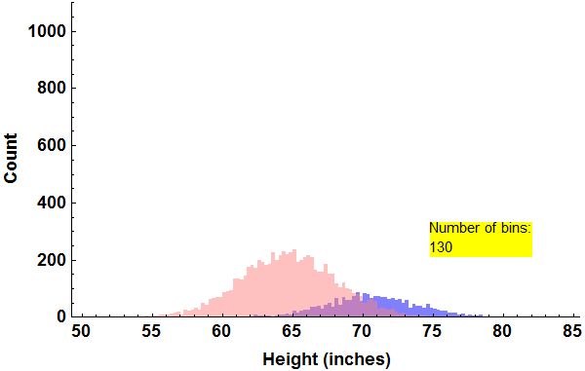
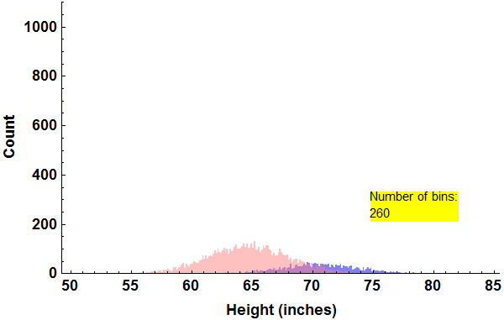
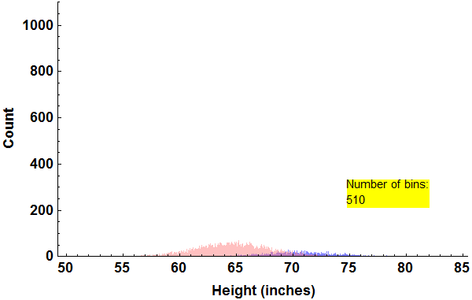
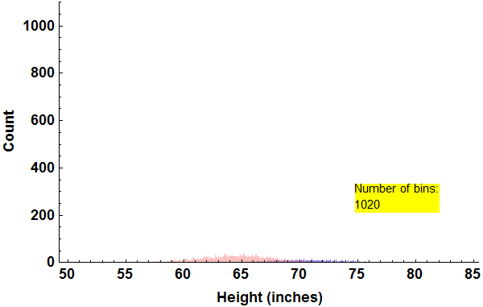
More and more bins. Good or bad?

Slide 19
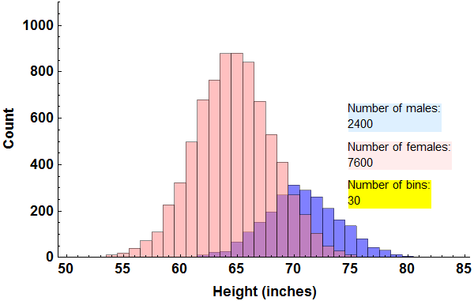
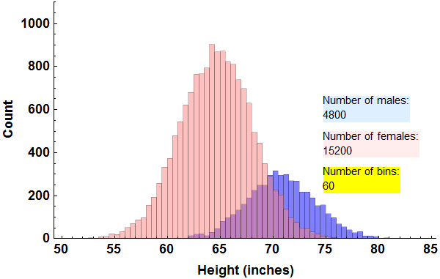
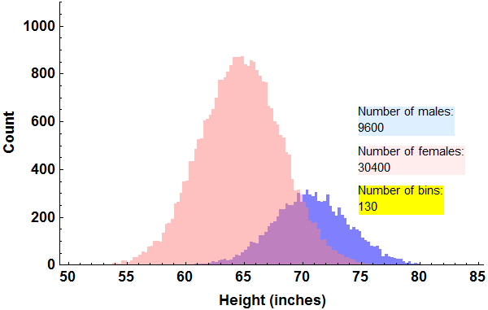



More and more bins. More and more samples.

Slide 20
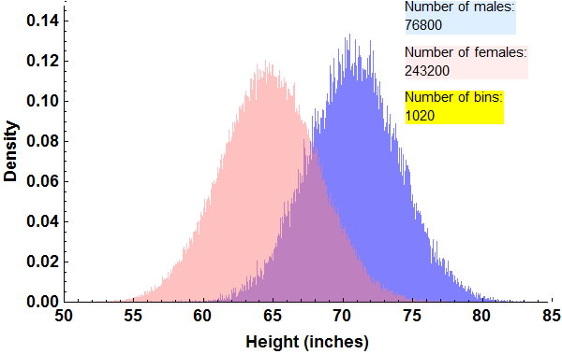
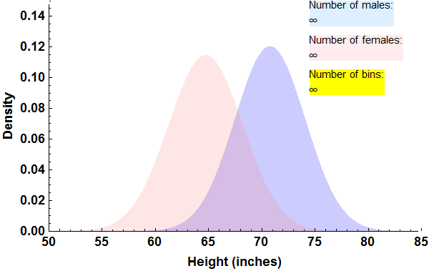
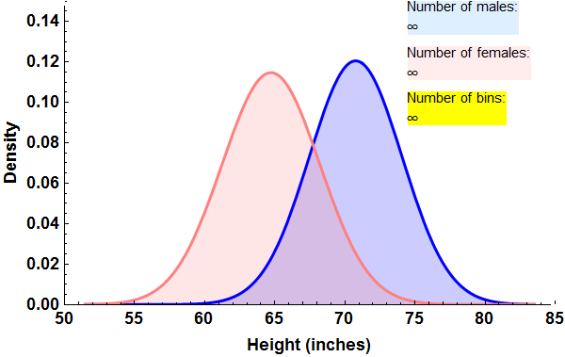
Normalized Histograms to PDFs
$$\frac{1}{\sqrt{2π}σ_{F}}e^{−\frac{1}{2}{\left(\frac{h−μ_{F}}{σ_{F}}\right)}^{2}}$$
$$\frac{1}{\sqrt{2π}σ_{M}}e^{−\frac{1}{2}{\left(\frac{h−μ_{M}}{σ_{M}}\right)}^{2}}$$

Slide 21
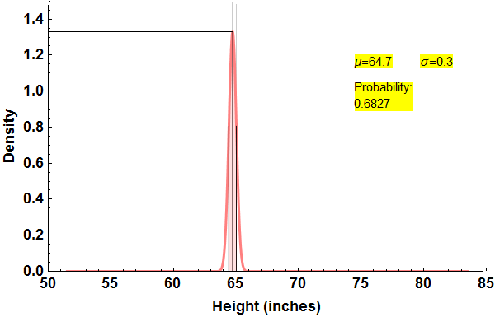
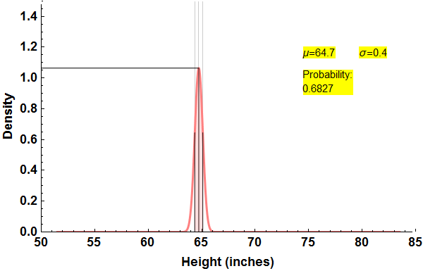
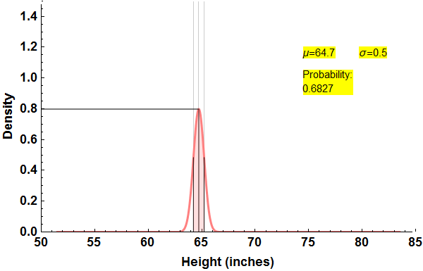
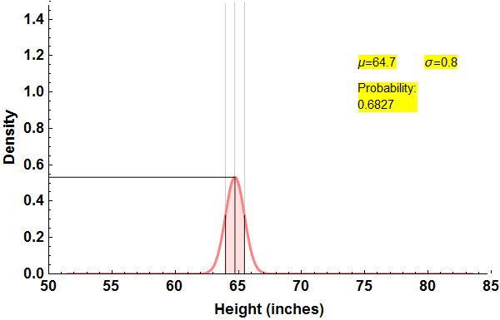
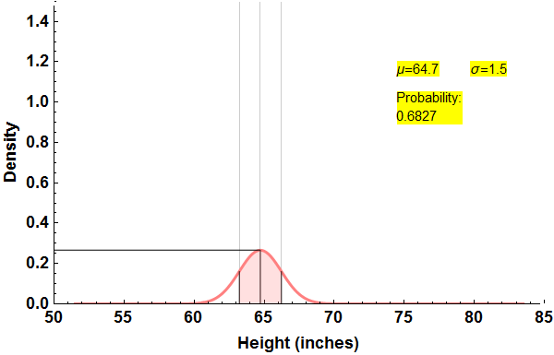
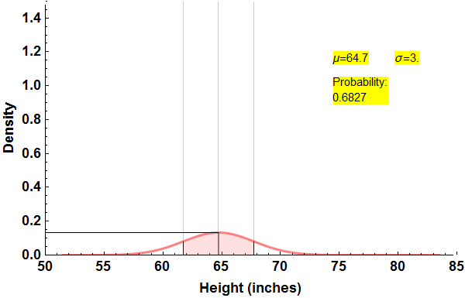
Mean, median, standard deviation … Boring statistics

Slide 22
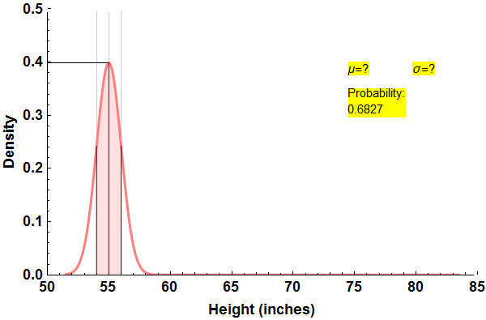

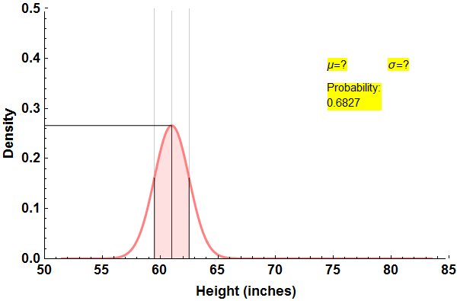

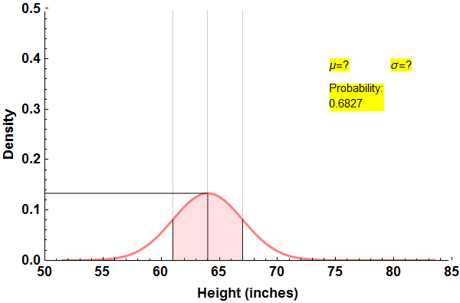

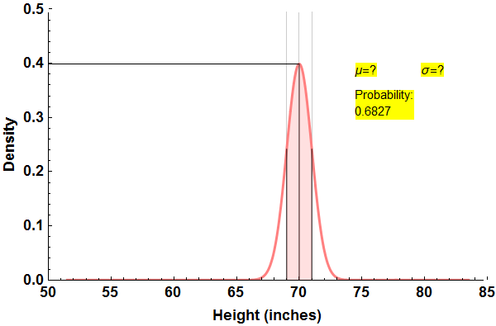

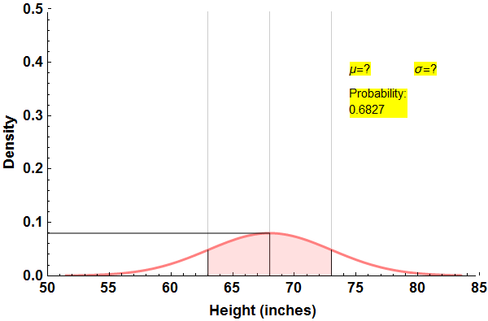

Mean, median, standard deviation … Boring statistics

Slide 23
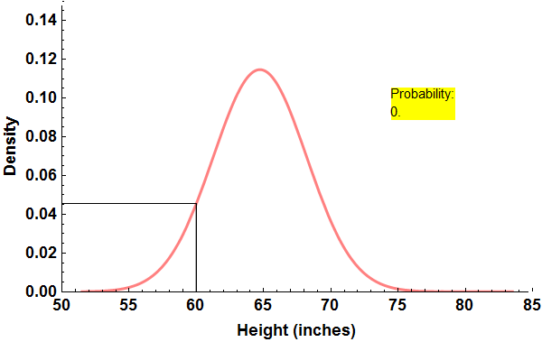
The Cardinal Sinner
The probability of “getting 60 inches is 0.045”
Never say that

Slide 24

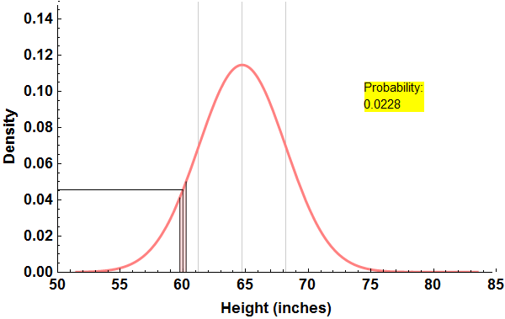
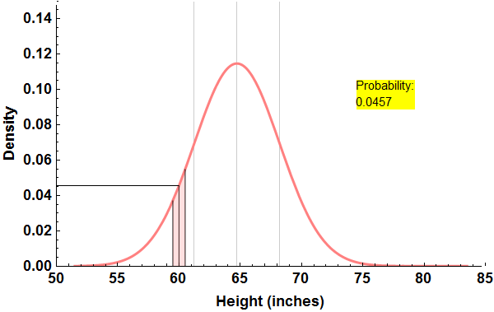
The Reformed
Width= 0 inch
Width= ½ inch
Width= 1 inch
2.28% of samples are inside the shaded strip
4.57% of samples are inside the shaded strip
If there are totally 1000 samples, there are
$$1000×\frac{1}{2}×0.0457≅23$$
samples inside the shaded strip
If there are totally 1000 samples, there are
$$1000×1×0.0457≅46$$
samples inside the shaded strip

Slide 25
Histograms, PDFs and probabilities
We have seen that we can build a classifier simply by using the training data to construct the “male and female histograms” separately i.e. $H_{M}\left(h\right)$ and $H_{F}\left(h\right)$
Question: If a given individual’s height is $x$ what is the probability that the individual is male?
Answer:
$$\frac{\text{Number} \text{of} \text{males} \text{in} \text{the} \text{bin} \text{containing} \text{the} \text{value} x }{\text{Total} \text{n}\text{umber} \text{of} \text{individuals} \text{in} \text{the} \text{bin} \text{containing} \text{the} \text{value} x }$$
$$\frac{H_{M}\left(x\right)}{H_{M}\left(x\right)+H_{F}\left(x\right)}$$
Or, using the PDF notation:
$\frac{N_{M}p_{M}\left(x\right)}{N_{M}p_{M}\left(x\right)+N_{F}p_{F}\left(x\right)}$ → $\frac{\frac{N_{M}}{N_{M}+N_{F}} p_{M}\left(x\right)}{\frac{N_{M}}{N_{M}+N_{F}} p_{M}\left(x\right)+\frac{N_{F}}{N_{M}+N_{F}} p_{F}\left(x\right)}$ → $\frac{P_{M}p_{M}\left(x\right)}{P_{M}p_{M}\left(x\right)+P_{F}p_{F}\left(x\right)}$
The presence of the denominator turns these quantities into probabilities.

Slide 26
Bayes Classifier (also, Theorem)
Let us break down the last expression which gives the quantity “Given an individual’s height as $x$ what is the probability that the individual is male?”
$$\frac{P_{M} p_{M}\left(x\right)}{P_{M} p_{M}\left(x\right)+P_{F} p_{F}\left(x\right)}$$
Or with some math swag: ($ω_{i}$ denotes “male” or “female” depending on $i=1 or 2$)
$$P\left(ω_{i}|x\right)=\frac{P\left(ω_{i}\right) p\left(x|ω_{i}\right)}{\sum_{j=1}^{2}{P\left(ω_{j}\right) p\left(x|ω_{j}\right)}}$$
What is the overall probability of getting M?
Given M what is the probability of getting $x$ ?
It is not sinful to make these two statements when we are talking about histograms.
What is the overall probability of getting F?
Given F what is the probability of getting $x$ ?
A priori probability
Class conditional probability density
Posterior probability

Slide 27
Bayes Classifier (also, Theorem)
Almost all of machine learning systems work by using a priori probabilities and class conditional probability density functions to compute the posterior probability
$$P\left(ω_{i}|x\right)=\frac{P\left(ω_{i}\right) p\left(x|ω_{i}\right)}{\sum_{j=1}^{2}{P\left(ω_{j}\right) p\left(x|ω_{j}\right)}}$$
If the class conditional probability density function happens to be one dimensional and normal, then the posterior probability (and the classifier) reduces to simple formulas involving means and standard deviations. Easy to calculate!
A priori probability
Class conditional probability density
Posterior probability

Slide 28

Multi-class, multidimensional generalizations
Multiclass classifier, $C$ classes:
$$P\left(ω_{i}|x\right)=\frac{P\left(ω_{i}\right) p\left(x|ω_{i}\right)}{\sum_{j=1}^{C}{P\left(ω_{j}\right) p\left(x|ω_{j}\right)}}$$
With multidimensional features,:
$$P\left(ω_{i}|x\right)=\frac{P\left(ω_{i}\right) p\left(x|ω_{i}\right)}{\sum_{j=1}^{C}{P\left(ω_{j}\right) p\left(x|ω_{j}\right)}}$$
If we find that the distributions are normal (Gaussian), we can simply use training data to find parameters such as the mean and standard deviation and use formulas to compute $p\left(x|ω_{i}\right)$
Other types of data distributions can be constructed as a sum of Gaussians.
Classify a given feature $x$by finding $P\left(ω_{1}|x\right),P\left(ω_{2}|x\right)$, $P\left(ω_{3}|x\right)$ … and choosing the class of the largest of those.
We now have a feature vector $x$ in place of the scalar feature $x$.
Take a look at Slide 1 again!

Slide 29
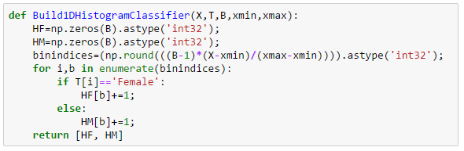
Step-by-Step: Pseudocode for computing the histogram
INPUT:
Data: $\left\{x_{0},x_{1},x_{2},…,x_{N−1}\right\}$ and specification of number of buckets $B$.
OUTPUT:
Histogram: $\left\{h_{0},h_{1},h_{2}, …,h_{B−1}\right\}$ where $h_{b}$ is the count of data samples falling in bin $b$
Initialize all the $h_{b}$ to 0
Find $x_{\text{min}}$ and $x_{\text{max}}$ , the minimum and maximum of the given data set
For $k=0 \text{through} N−1$, do
$b=\text{ROUND}\left(\left(B−1\right)\left(\frac{x_{k}−x_{\text{min}}}{x_{\text{max}}−x_{\text{min}}}\right)\right)$
$h_{b}$=$h_{b}$+1
Return $\left\{h_{0},h_{1},h_{2},…,h_{B−1}\right\}$
It is best to implement this as a function $b=BF(x)$ so that it can be easily called where needed

Slide 30
Step-by-Step: Homework Assignment 1 (unofficial, always refer to the course website)
Assignment Instructions
The data set that you need is in one of the sheets of the Excel file Assignment_1_Data_and_Template.xlsx. The other three sheets contain shaded cells meant to be filled in by you. Examine the sheets carefully and understand what must be computed or described.
Construct separate histograms for male and female heights using 32 bins. Do not use a built in histogram program.
Based on the histograms, compute the probability of being female of individuals with heights 55, 60, 65, 70, 75 and 80 inches
Find the parameters of Gaussian models for the 2 PDFs to describe the data. You may use built in functions to compute the model parameters.
Use the Bayesian Formula with the model parameters found above to re-compute the probability of being female of individuals with heights 55, 60, 65, 70, 75 and 80 inches
Repeat steps 2 through 5 using just the first 50 height entries in the data file. Now what are your observations regarding histogram classifiers and Bayesian classifiers?
Solution steps
Histogram construction (use the method described in Lecture 1)
Import data from the file. Preprocess to convert samples given in feet and inches to proper decimal representation. Let $X=\left\{x_{0},x_{1},x_{2},…,x_{N−1}\right\}$ represent the heights and $T=\left\{t_{0},t_{1},t_{2},…,t_{N−1}\right\}$ represent the corresponding target class labels (genders).
Set the number of histogram bins $B=32$.
Find $x_{\text{min}}$ and $x_{\text{max}}$ , the minimum and maximum of the set $X$ (which includes samples from both genders).
Create a function $b=BF(x)$ to map a given sample $x$ to a bin index $b$. (Step 3 in the previous slide, make sure you use the entire data to calculate $x_{\text{min}}$ and $x_{\text{max}}$)
Use the above function to find the two histograms $H_{F}=\left\{h_{F0},h_{F1},h_{F2},…,h_{F[B−1]}\right\}$ and $H_{M}=\left\{h_{M0},h_{M1}, h_{M2}, …,h_{M[B−1]}\right\}$.
Let $x$ be the height (e.g. 55”) for which we need to predict the gender and compute the probability of being male. Find the bin index $b=BF(x)$ and predict the most likely gender by comparing the histogram entries $h_{Fb}$ and $h_{Mb}$. Compute the probability of being female as ${h_{Fb}}/{\left(h_{Fb}+h_{Mb}\right)}$

Slide 31
Step-by-Step: Homework Assignment 1
Solution steps
Find the mean and standard deviation* of the heights separately for females and males. Denote the parameters as $μ_{F}$, $μ_{M}$, $σ_{F}$, $σ_{M}$. Find the total count of females and males in the training set, $N_{F}$ and $N_{M}$.
Let $x$ be the height (e.g. 55”) for which we need to predict the gender and compute the probability of being male. Use the Bayesian classifier formula given below. The right hand side divided by the sum of the left-hand & right-hand sides is the estimated the probability of being female
Redo steps 2 through 5 using $X=\left\{x_{0},x_{1},x_{2}, …,x_{49}\right\}$. The results are better compared if the old values of ${B, x}_{\text{min}}$ and $x_{\text{max}}$ are reused. The histograms and the Gaussian model parameters have to be recomputed. Use previously computed values of $x_{\text{min}}$ and $x_{\text{max}}$
What are your observations?
$$N_{M}\left(\frac{1}{\sqrt{2π}σ_{M}}e^{−\frac{1}{2}{\left(\frac{x−μ_{M}}{σ_{M}}\right)}^{2}}\right)$$
M
$$N_{F}\left(\frac{1}{\sqrt{2π}σ_{F}}e^{−\frac{1}{2}{\left(\frac{x−μ_{F}}{σ_{F}}\right)}^{2}}\right)$$
>
<
F
*You may use built-in functions for finding these parameters. Remember to use the appropriate options to divide by N-1 in the formula for standard deviation.

Slide 32
Schedule of Assignments
Team Project
Your Choice!
Assignment 6
Assignment 5
Unsupervised Learning
Assignment 4
Decision Trees
Assignment 3
Linear Classifiers
Assignment 2
Assignment 1
Principal Component Analysis
2D Histograms and Bayesian Classifiers
July 5, 2017
1D Histograms and Bayesian Classifiers

Slide 33
Lecture 2: Is the Gaussian probability density function boring?
Correlations between features
Covariance Matrix: Summary of correlations between features
Covariance: What does it measure?
Covariance versus variance
Bayes Classifier (d DIMENSIONS)
Covariance Interpretation Practice
Step-by-step: PDF of the binormal distribution
Calculation of the PDF of the binormal distribution
Calculation of the PDF of the multinormal distribution
Assignment 2 (unofficial)
Step-by-step: How can I build 2D Histograms?
Step-by-step: How can I build a 2D Bayesian Classifier?
Linear Transformations
What does linearity mean?
What do the entries in a matrix signify?
Histogram & PDF Q & A
Recap Histogram & Bayes Classifier (MAKE SURE YOU FULLY UNDERSTAND THIS)
Histogram & Bayes Classifier (TWO DIMENSIONS)
Histogram & Bayes Classifier (TWO DIMENSIONS)
Histogram & Bayes Classifier (TWO DIMENSIONS)
Two Dimensional Data overlaid on Contour Plots of the PDFs
Two Dimensional Gaussian Intuition
Two Dimensional Gaussian Intuition (more general)
What does an “outlier” mean?
How do I specify a 1D point cloud?
How do I specify a 2D point cloud?
How do I specify a 2D point cloud?

Slide 34
Histogram & PDF Q & A
Q1 In constructing a histogram from first principles, how do I find the count of samples in a given bin centered at x having a width of w ?
A1 You go through all the data given to you and count the number of samples falling in that bin i.e. in the range $x±\frac{w}{2}$.
Q2 What can I do if my histogram looks bad because I don't have sufficient data? Would my histogram obtained by counting be reliable?
A2 You can sidestep the actual counting process and estimate what that count should have been by using a simple formula. This trick works if the data is normally distributed. This is often the case.
Q3 What is that formula?
A3 Here it is. The familiar looking one: $N W \left(\frac{1}{\sqrt{2π} σ}\right)e^{−\frac{1}{2}{\left(\frac{x−μ}{σ}\right)}^{2}}$ where
$N$ = Number of samples
$W$ = Width of the bin for which you are trying to find the count
$σ$ = Standard deviation of the data
$μ$ = Mean of the data
$x$ = Center of the bin for which you are trying to find the count
Q4 I know how to build a histogram classifier ... Can I use this trick to sidestep counting and build a classifier without building histograms first?
A4 Aha! Now you have understood the point of the Bayesian Classifier.

Slide 35
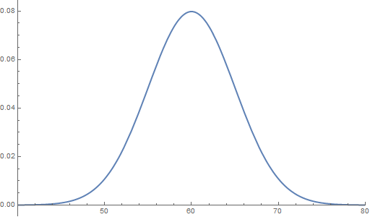
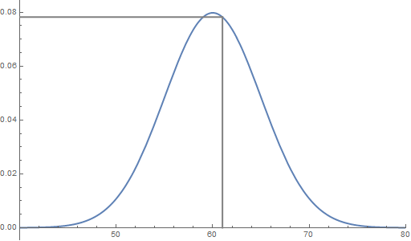
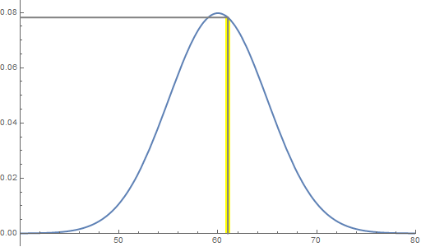
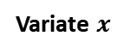
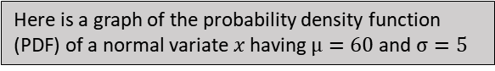


Histogram & PDF Q & A
Here is a graph of the probability density function (PDF) of a normal variate $x$ having $μ=60$ and $σ=5$
0.078
Just because you can read off the function value 0.078 at $x=61$, you can’t say “the probability of getting 61 is 0.078.”
Remember, the vertical axes is probability density, not probability.
Probability Density
However, it is perfectly OK to say “the probability of getting an $x$ within $61±\frac{1}{4}$ is $0.078×\frac{1}{2}=0.039$”
Variate $x$
61

Slide 36




















Recap Histogram & Bayes Classifier (MAKE SURE YOU FULLY UNDERSTAND THIS)
Bayes theorem can be used to answer the question “Given that an individual’s height is $x$, what is the probability that the individual is female?”
The prevalence terms $P\left(F\right)$ and $P(M)$ are easily found from counts of the total number of F and M in the training set
The class conditional terms $p\left(x|F\right)$and $p\left(x|M\right)$can be found using normalized histograms constructed from training data. Or, if the distributions happen to be normal (Gaussian), $p\left(x|F\right)$and $p\left(x|M\right)$are found using formulas containing means and standard deviations of samples from the classes taken separately
If it is easier, just remember the simple form
Given F what is the probability of getting $x$ ?
What is the prevalence of F?
$$P(F)$$
$$p\left(x|F\right)$$
$$P_{F}$$
$$p_{F}\left(x\right)$$
+
It is not correct to say “… the probability of getting $x$”. However, it is not sinful to make these two statements when PDFs appear in ratios.
$$P(F)$$
$$p\left(x|F\right)$$
+
$$p\left(x|M\right)$$
$$P_{F}$$
$$p_{F}\left(x\right)$$
$$P_{M}$$
$$p_{M}\left(x\right)$$
$$P(M)$$
What is the prevalence of M?
Given M what is the probability of getting $x$ ?
$$M$$
$P(M)$ $p\left(x|M\right)$
>
$P(F)$ $p\left(x|F\right)$
<
$$F$$

Slide 37


Histogram & Bayes Classifier (TWO DIMENSIONS)
In an attempt to obtain more accurate classification, we will consider an additional feature, handspan denoted by $s$. Again we can build a simple classifier to determine gender from height by constructing “male and female histograms” separately i.e. $ℋ_{M}\left(h,s\right)$ and $ℋ_{F}\left(h,s\right)$ this time in two dimensions
Query: Given an individual’s height $x$ and handspan $y$ we can easily “run the classifier” shown below to determine the likely gender
M
$$ℋ_{M}\left(x,y\right)$$
>
$$ℋ_{F}\left(x,y\right)$$
<
F
Think about the question: What formulas can we use to approximate the histograms?

Slide 38



Histogram & Bayes Classifier (TWO DIMENSIONS)
In order to classify using two features (height and handspan) we need to use the following formula which generalizes the PDF from one dimension to two dimensions
2D PDF $\frac{1}{ 2π{ \left|Σ\right|}^{\frac{1}{2}}}e^{−\frac{1}{2} \left(x−μ\right) Σ^{−1} {\left(x−μ\right)}^{T}}$
1D PDF $\frac{ 1}{\sqrt{2π} σ }{ e}^{−\frac{1}{2} \left(x−μ\right){ σ}^{−2}\left(x−μ\right)}$
Note that $x$is now a vector specifying an individual’s height and handspan. The scalar parameters mean and standard deviation (e.g. $μ_{F}$ and $σ_{F}$) are now replaced with the mean vector and the covariance matrix (e.g. $μ_{F}$ and $Σ_{F}$)
The mean vectors and the covariance matrices contain information about the location and shape of the 3D histograms shown on the previous slide. The classifier formula is
$$N_{M}\left(\frac{1}{2π{ \left|Σ_{M}\right|}^{\frac{1}{2}}}e^{−\frac{1}{2}\left(x−μ_{M}\right) {Σ_{M}}^{−1}{\left(x−μ_{M}\right)}^{T}}\right)$$
M
$$N_{F}\left(\frac{1}{2π{ \left|Σ_{F}\right|}^{\frac{1}{2}}}e^{−\frac{1}{2}\left(x−μ_{F}\right) {Σ_{F}}^{−1}{\left(x−μ_{F}\right)}^{T}}\right)$$
>
<
F

Slide 39

Histogram & Bayes Classifier (TWO DIMENSIONS)

Slide 40


Two Dimensional Data overlaid on Contour Plots of the PDFs
Males
Females
Data scientists sometimes refer to collections of samples as “point clouds.”

Slide 41



Two Dimensional Gaussian Intuition
Data generated by an unskilled marksman aiming for the point {4,8}. Good luck!
Some more tries …
Even more tries …
Errors are independent of orientation.
Errors in x are independent of errors in y.
Large errors are less probable

Slide 42



Two Dimensional Gaussian Intuition (more general)
Errors are dependent on orientation.
Errors in x are dependent on errors in y.
Large errors are less probable

Slide 43

What does an “outlier” mean?
Not an outlier
Is an outlier

Slide 44


How do I specify a 1D point cloud?
Assuming that the points are normally distributed …

Slide 45


How do I specify a 2D point cloud?
Assuming that the points are bi-normally distributed …

Slide 46


How do I specify a 2D point cloud?
The standard deviations alone are NOT sufficiently descriptive.

Slide 47





Correlations between features
Fraction Owning home
Fraction foreign-born
Median home price
Mean home price

Slide 48

Covariance Matrix: Summary of correlations between features

Slide 49

Covariance: What does it measure?
Features
Feature Vectors
N=6
d=7
Are these two features related?
More specifically, are they linearly correlated?
Still more specifically, what is the amount of linear correlation between these two features?

Slide 50





Covariance versus variance
Mean Vector
$$σ_{3}^{2}=\frac{1}{6−1}\sum_{k=1}^{6}{\left(x_{k3}−{\overline{x}}_{3}\right)\left(x_{k3}−{\overline{x}}_{3}\right)}$$
Variance of $x_{3}$ (feature 3)
$$c_{36}=\frac{1}{6−1}\sum_{k=1}^{6}{\left(x_{k3}−{\overline{x}}_{3}\right)\left(x_{k6}−{\overline{x}}_{6}\right) }$$
Covariance between $x_{3}$ and $x_{6}$

Slide 51



Bayes Classifier (d DIMENSIONS)
In order to classify using d features (height, handspan, voice frequency, … ) we need to use the following formula which contains a generalization of the normal PDFs
Try approximating (using a common covariance matrix $Σ$):
$$N_{M}\left(\frac{1}{{\left(2π\right)}^{\frac{d}{2}}{\left|Σ_{M}\right|}^{\frac{1}{2}}}e^{−\frac{1}{2}\left(x−μ_{M}\right) {Σ_{M}}^{−1}{\left(x−μ_{M}\right)}^{T}}\right)$$
M
$$N_{F}\left(\frac{1}{{\left(2π\right)}^{\frac{d}{2}}{\left|Σ_{F}\right|}^{\frac{1}{2}}}e^{−\frac{1}{2}\left(x−μ_{F}\right) {Σ_{F}}^{−1}{\left(x−μ_{F}\right)}^{T}}\right)$$
>
<
F
$$\left\{1×d\right\}$$
$$\left\{d×d\right\}$$
$$\left\{d×1\right\}$$
Turns out to be a scalar, real number
M
$$N_{M} 𝒩\left(x|μ_{M},Σ_{M}\right)$$
>
$$N_{F} 𝒩\left(x|μ_{F},Σ_{F}\right)$$
<
F
$$N_{M}\left(−\frac{1}{2}\left(x−μ_{M}\right) Σ^{−1}{\left(x−μ_{M}\right)}^{T}\right)$$
M
$$N_{F}\left(−\frac{1}{2}\left(x−μ_{F}\right)Σ^{−1}{\left(x−μ_{F}\right)}^{T}\right)$$
>
<
F

Slide 52




Covariance Interpretation Practice

Slide 53

Step-by-step: PDF of the binormal distribution
It is highly recommended that you define a general function to compute the PDF of a Gaussian distribution in multiple dimensions. At least once, calculate an example by hand (the calculation of the inverse is optional) and track all the intermediate results

Slide 54




Calculation of the PDF of the binormal distribution
The PDF of a Gaussian distribution in two dimensions is given by
where $x$ and $μ$ are two dimensional vectors and $Σ$ is a $2×2$ matrix.
The expression for the PDF can be written in a form more suitable for computation by writing out the variables and parameters explicitly:
$$x=\left\{x_{1},x_{2}\right\} \text{and} μ=\left\{μ_{1},μ_{2}\right\}$$
$$Σ=\left(\begin{matrix}c_{11} & c_{12} \\ c_{21} & c_{22}\end{matrix}\right)$$
Then, the determinant in the expression turns out to be $\left|Σ\right|=c_{11}c_{22}−c_{12}c_{21}$
The argument of the exponential turns out to be
It is highly recommended that you define a general function to compute the PDF of a Gaussian distribution in multiple dimensions.

Slide 55









Calculation of the PDF of the multinormal distribution
The inverse ($d×d$) of the covariance matrix for a given numerical dataset ($N×d$) can be found using callable functions available in most numerical software development platforms.
For the simple case of a $2×2$ covariance matrix $\left[\begin{matrix}c_{11} & c_{12} \\ c_{21} & c_{22}\end{matrix}\right]$, the inverse is readily calculated as $\left[\begin{matrix}c_{22} & −c_{12} \\ {−c}_{21} & c_{11}\end{matrix}\right]/\left(c_{11}c_{22}−c_{12}c_{21}\right)$.
Click on any box inside this formula to get a description. Click on the same box again to dismiss.
The covariance matrix ($d×d$) for a given numerical dataset ($N×d$) can be found using callable functions available in most numerical software development platforms.
$$\frac{1}{{\left(2π\right)}^{\frac{d}{2}}\sqrt{\left|Σ\right|}}e^{−\frac{1}{2} \left(x−μ\right) Σ^{−1}{\left(x−μ\right)}^{T}}$$
For a given feature vector $x$the scalar quantity $\left(x−μ\right) Σ^{−1}{\left(x−μ\right)}^{T}$ can be found using matrix multiplication functions available in most numerical software development platforms.
Alternatively, by defining the $d$- dimensional vector $z=x−μ$ and the matrix ${A=Σ}^{−1}$, the equivalent scalar quantity $z A z^{T}$ is easily calculated as $\sum_{j=1}^{d}{\sum_{k=1}^{d}{z_{j}z_{k}a_{jk}}}$
The determinant of the covariance matrix can be found using callable functions available in most numerical software development platforms.
For the simple case of a $2×2$ covariance matrix $\left[\begin{matrix}c_{11} & c_{12} \\ c_{21} & c_{22}\end{matrix}\right]$, the determinant is readily calculated as $c_{11}c_{22}−c_{12}c_{21}$.
Next Slide

Slide 56
Assignment 2 (unofficial)
The data set that you need is in one of the sheets of the Excel file Assignment_2_Data_and_Template.xlsx. The other sheets contain shaded cells meant to be filled in by you. Examine the sheets carefully and understand what must be computed or described.
Construct separate 2D histograms for male and female heights. You decide on the number of bins to use, making sure there is sufficient resolution and bin-filling. Do not use a built-in histogram program.
Find the parameters of two 2D Gaussian models for the 2 PDFs to describe the data. You may use built-in functions to compute these parameters
Based on the histograms and Gaussian models, compute the likely gender (given as the probability of being female) of individuals with measurements as given below (Height in inches, handspan in centimeters). What are your observations?
Height Handspan 69 17.5 66 22 70 21.5 69 23.5
Extra credit: Reconstruct a histogram using female model parameters that can be compared to the female histogram constructed in Part 2. Similarly, reconstruct a histogram using male model parameters.

Slide 57

Step-by-step: How can I build 2D Histograms?
Set the number of histogram bins using Sturges’s Rule 𝐵=$\left\lceil \left(\log_{2}{N}\right)+1\right\rceil$ or other considerations. E.g. B=15. Here, $N$ refers to the number of samples in Class F or Class M, assumed to be equal. For simplicity, you may use the same number of bins for both the features.
Assume that the data is given as $X=\left\{\left\{h_{1},s_{1}\right\},\left\{h_{2},s_{2}\right\},\left\{h_{3},s_{3}\right\},…\right\}$ where the heights are $h_{i}$, the handspans are $s_{i}$ and the genders are given as $G=\left\{g_{1},g_{2},g_{3},…,g_{N}\right\}$.
Construct separate 2D histograms for the two classes. One way to do this is to first initialize (with zeros) two matrices $H_{F}$ and $H_{M}$, each of size $B×B$. Next, compute the minimum and maximum of each of the features found in the training data (irrespective of class). Let us call these limits $h_{min}$, $h_{max}$, $s_{min}$, and $s_{max}$. The matrices $H_{F}$ and $H_{M}$ will now be subjected to a sequence of updating operations till the histograms are built up.
For every feature vector $\left\{h_{i},s_{i}\right\}$ pair belonging to the training set, do:
Transform $\left\{h_{i},s_{i}\right\}$ to row-column indices $\left\{r,c \right\}$ using
$r=ROUND\left(1+(B−1)\left(\frac{h_{i}−h_{min}}{h_{max}−h_{min}}\right)\right)$
$c=ROUND\left(1+(B−1)\left(\frac{s_{i}−s_{min}}{s_{max}−s_{min}}\right)\right)$
If gender $g_{i}=F$, update $H_{F}$ as $H_{F}\left[r,c\right]=H_{F}\left[r,c\right]+1$. Otherwise, update $H_{M}$ as $H_{M}\left[r,c\right]=H_{M}\left[r,c\right]+1$.
Caution: The array indices shown in the lecture notes start from 1. Remember to account for this when you write your Python code.

Slide 58

Step-by-step: How can I build a 2D Bayesian Classifier?
Separate the data into male and female subsets
Find the mean vector and the covariance matrix separately for males and females. You may use a built-in function to compute these parameters.
For each requested query (height-handspan vector $x=\left\{h,s\right\}$) compute the posterior probabilities
$$p\left(F|x\right)=\frac{N_{F}\left(\frac{1}{2π{ \left|Σ_{F}\right|}^{\frac{1}{2}}}e^{−\frac{1}{2}\left(x−μ_{F}\right) {Σ_{F}}^{−1}{\left(x−μ_{F}\right)}^{T}}\right)}{\left(N_{M}\left(\frac{1}{2π{ \left|Σ_{M}\right|}^{\frac{1}{2}}}e^{−\frac{1}{2}\left(x−μ_{M}\right) {Σ_{M}}^{−1}{\left(x−μ_{M}\right)}^{T}}\right)\right)+\left(N_{F}\left(\frac{1}{2π{ \left|Σ_{F}\right|}^{\frac{1}{2}}}e^{−\frac{1}{2}\left(x−μ_{F}\right) {Σ_{F}}^{−1}{\left(x−μ_{F}\right)}^{T}}\right)\right)}$$
$$p\left(M|x\right)=\frac{N_{M}\left(\frac{1}{2π{ \left|Σ_{M}\right|}^{\frac{1}{2}}}e^{−\frac{1}{2}\left(x−μ_{M}\right) {Σ_{M}}^{−1}{\left(x−μ_{M}\right)}^{T}}\right)}{\left(N_{M}\left(\frac{1}{2π{ \left|Σ_{M}\right|}^{\frac{1}{2}}}e^{−\frac{1}{2}\left(x−μ_{M}\right) {Σ_{M}}^{−1}{\left(x−μ_{M}\right)}^{T}}\right)\right)+\left(N_{F}\left(\frac{1}{2π{ \left|Σ_{F}\right|}^{\frac{1}{2}}}e^{−\frac{1}{2}\left(x−μ_{F}\right) {Σ_{F}}^{−1}{\left(x−μ_{F}\right)}^{T}}\right)\right)}$$
See “Calculation of the PDF of the binormal distribution” for hints on computing the shaded quantities.
Perform classification by comparing $p\left(F|x\right)$ and $p\left(M|x\right)$.

Slide 59





Linear Transformations

Slide 60


What does linearity mean?
Lines are mapped to lines
Equally spaced lines are mapped to equally spaced lines
Lines passing through the origin are mapped to lines passing through the origin

Slide 61


What do the entries in a matrix signify?
Each row of a matrix specifies “where that basis vector goes” after the transformation

Slide 62
Lecture 3: Principal Component Analysis
Looking good, Bayesian!
Looking good, Bayesian!
Looking good, histogram!
Classification in high dimensional feature spaces
The problem with histograms: The Curse of Dimensionality
Linear Transformations
What does linearity mean?
What do the entries in a matrix signify?
What is an eigenvector? In 3D
“Usual” Components versus Principal Components
What distinguishes an eigenvector?
What does an eigenvector have to do with matrices? Ex. 1
What does an eigenvector have to do with matrices? Ex. 2
XZCVPR
XZCVPR
XZCVPR
XZCVPR
XZCVPR: Implementation in practice
“Usual” Components versus Principal Components, again
Application: The MNIST database of handwritten digits
The numerical structure of a single handwritten digit image
Digits represented as feature vectors
Dimension reduction of digit feature vectors
Low Dimensional Approximations (The MNIST database of handwritten digits)
A 2D scatterplot of the first two principal components
Assignment 3: 100 points (unofficial version)
What is the point? How is PCA practically useful?
How many PCA components do I need to use?
PCA in pictures
PCA in pictures (contd)

Slide 63

Looking good, Bayesian!
HP Autonomy’s headquarters in Cambridge, UK.

Slide 64






Looking good, Bayesian!
Updated
Belief
=
Prior
Belief
×
Extra
Information
$$p(A|x)$$
=
$$P(A)$$
×
$$p(x|A)$$
$$p(B|x)$$
=
$$P(B)$$
×
$$p(x|B)$$
Posterior
Prior
Likelihood
Note:
Prior and likelihood do not need to be probabilities
Posterior MUST be a probability I.e. 𝑝(𝐴|𝑥)+𝑝(B|𝑥)=1

Slide 65





Looking good, histogram!
An edible arrangement of histogram bins in 2D
The “prepare in advance” method
The “wait for a query” method
Note: For each class, a total of 36 bins were filled to draw this histogram. Bins with a count of 0 are not shown.

Slide 66

Classification in high dimensional feature spaces
Dictionary
=
{Word 1, Word 2, Word 3, Word 4, … }
Document 1:
Dic Word 1:
Freq 1
Dic Word 2:
Freq 2
Dic Word 3:
Freq 3
Dic Word i:
Freq i
Dic Word d:
Freq d
Spam
Document 2:
Dic Word 1:
Freq 1
Dic Word 2:
Freq 2
Dic Word 3:
Freq 3
Dic Word i:
Freq i
Dic Word d:
Freq d
Ham
Document N:
Dic Word 1:
Freq 1
Dic Word 2:
Freq 2
Dic Word 3:
Freq 3
Dic Word i:
Freq i
Dic Word d:
Freq d
Spam

Slide 67



The problem with histograms: The Curse of Dimensionality
Profusion of useless bins
$$H_{2}$$
$$H_{1}$$
The Curse of Dimensionality becomes more and more serious as more and more features are added to a given number of samples

Slide 68
Linear Transformations

Slide 69
What does linearity mean?
Lines are mapped to lines
Equally spaced lines are mapped to equally spaced lines
Lines passing through the origin are mapped to lines passing through the origin

Slide 70
What do the entries in a matrix signify?
Each row of a matrix specifies “where that basis vector goes” after the transformation

Slide 71



What is an eigenvector? In 3D

Slide 72




“Usual” Components versus Principal Components
$$\left\{1,0\right\}.\left\{x,y\right\}$$
$$v_{1}.\left\{x,y\right\}$$
$$v_{2}.\left\{x,y\right\}$$
$$\left\{0,1\right\}.\left\{x,y\right\}$$
“Usual” y component
“Usual” y basis vector
Second principal component
Second eigenvector $v_{2}$
First principal component
First eigenvector $v_{1}$
“Usual” x component
“Usual” x basis vector
How do we find the eigenvectors $v_{1}$ and $v_{2}$ for a given point cloud?
$$v_{1}=\{+0.92, +0.38\}$$
$$v_{2}=\{−0.38, +0.92\}$$

Slide 73




What distinguishes an eigenvector?

Slide 74










What does an eigenvector have to do with matrices? Ex. 1

Slide 75




What does an eigenvector have to do with matrices? Ex. 2
Eigenvectors are indispensable for dimension reduction. How?

Slide 76


XZCVPR
$$X=$$
$${\overline{x}}_{j}=\frac{1}{N}\sum_{k=1}^{N}{\begin{aligned} \\ x_{kj} \end{aligned}}$$
$$\overline{x}=$$
$$Z=$$
$$z_{ij}=x_{ij}−{\overline{x}}_{j}$$
$$\left\{N×d\right\}$$

Slide 77


XZCVPR
$$c_{ij}=\frac{1}{N−1}\sum_{k=1}^{N}{z_{ki} z_{kj} }$$
$$C=$$
The covariance matrix has a number of special properties. Among them are:
Entries on the principal diagonal, being variances, must always be positive (see thin line)
Symmetrical entries (such as the two entries shown shaded) must be equal to one another
$$\left\{d×d\right\}$$
The eigenvectors of the covariance matrix are easily computed using scientific software.
Given a point cloud (set of feature vectors), each eigenvector identifies a special direction of variance maximizing radius
Most software packages compute eigenvectors as unit vectors that are perpendicular to each other
$$V=$$
Normalized
Eigenvectors
$$\left\{d×d\right\}$$

Slide 78


XZCVPR
$$P=$$
$$\left\{N×d\right\}$$
$$\left\{d×d\right\}$$
$$P=$$
$$=ZV^{T}$$
Note: $V$ is an orthogonal matrix.
$V^{−1}$=$V^{T}$
$$\left\{N×d\right\}$$

Slide 79
XZCVPR
$$R=$$
$$\left\{N×d\right\}$$
$$\left\{d×d\right\}$$
$R=PV$ i.e. $Z$ is recovered. How do we recover $X$?
$$R\tilde{=}$$
$$\left\{3×d\right\}$$
$$\left\{N×3\right\}$$

Slide 80

XZCVPR: Implementation in practice
X
Simple arithmetic and programming loop
Z
Z
Built-in function recommended
Z
C
Built-in function recommended
here if doing PCA for
classification
Z
V
Built-in function or simple arithmetic and programming loop
Z
P
Built-in function or simple arithmetic and programming loop
R

Slide 81




“Usual” Components versus Principal Components, again
PCA
PCA

Slide 82

Application: The MNIST database of handwritten digits

Slide 83


The numerical structure of a single handwritten digit image

Slide 84

Digits represented as feature vectors

Slide 85


































Dimension reduction of digit feature vectors
Before PCA
After PCA
$$x_{1,1}$$
$$x_{1,2}$$
$$x_{1,3}$$
… $x_{1,784}$
$$p_{1,1}$$
$$p_{1,2}$$
$$p_{1,3}$$
… $p_{1,?}$
$$x_{2,1}$$
$$x_{2,2}$$
$$x_{2,3}$$
… $x_{2,784}$
$$p_{2,1}$$
$$p_{2,2}$$
$$p_{2,3}$$
… $p_{2,?}$
$$x_{3,1}$$
$$x_{3,2}$$
$$x_{3,3}$$
… $x_{3,784}$
$$p_{3,1}$$
$$p_{3,2}$$
$$p_{3,3}$$
… $p_{3,?}$
. . . .
. . . .
$$x_{N,1}$$
$$x_{N,2}$$
$$x_{N,3}$$
… $x_{N,784}$
$$p_{N,1}$$
$$p_{N,2}$$
$$p_{N,3}$$
… $p_{N,?}$
$$\left\{N×784\right\}$$
$$\left\{N×?\right\}$$
Guess what “?” Turns out to be!

Slide 86








Low Dimensional Approximations (The MNIST database of handwritten digits)
Note: The count is given
by the depth of red/green color
Approximation using
1 principal component
Approximation using
2 principal components
Approximation using
3 principal components
Approximation using
30 principal components
Original
A 30 dimensional histogram
is being imagined by this mind
Digit “1”
Digit “2”

Slide 87

A 2D scatterplot of the first two principal components
782 of the 784 dimensions can be discarded!
Question: How do we go about building a classifier to distinguish between the two digits?
Digit “1”
Digit “2”

Slide 88
Lecture 4: Principal Component Analysis (more details)
Assignment 3: 200 points
XZCVPR
XZCVPR
XZCVPR
XZCVPR
XZCVPR
What is the point? How is PCA practically useful?
2D Histogams: Creating the classifier
2D Histogams: Applying the classifier
Gaussian models
Examples
Why does the classifier make mistakes?
How many PCA components do I need to use?
Classifier Performance
Classifier Performance (Binary)
Accuracy (Binary)
Sensitivity (Binary)
Specificity (Binary)
Positive Predictive Value (Binary)
Confusion Matrix
Positive Predictive Value
PCA in pictures
PCA in pictures (contd)
How do I ace Assignment 3?

Slide 89
Assignment 3: 200 points Always confirm that this is the official version of the assignment
The topic of this assignment is very foundational, and the systematic steps you need to take in solving this problem is typical of many practical applications in machine learning. Please think about every computational step you take, and make use of the suggested checks for correctness that we covered (or will cover) in class. Feel free to design your own checks. An example of what you should NOT do: entering xp and zp into the spreadsheet without first verifying that xp-mu is indeed equal to zp (to at least 0.000001 tolerance). Please take advantage of the extra time allowed for this assignment and reward yourself with a great learning experience. Enjoy the transition from "I have been exposed to machine learning" to "I am becoming quite good at machine learning!"
This assignment calls for using principal component analysis and histogram/Bayesian concepts for classifier design and evaluation.
Use the attached Excel spreadsheet as a template to report your results. Except for cutting and pasting your results, do not alter the spreadsheet in any other way. This is the only recognized means of submitting this assignment. An extra sheet has been provided just in case you wish to make [optional] interesting observations. Read through these instructions and examine the spreadsheet carefully to understand what must be computed or described.
Import handwritten digit data from yann.lecun.com/exdb/mnist (four files). Refer to the Python code suggested in Read_MNIST.html to read and parse the data.
Prepare the data you will use for this assignment by limiting the imported data to two specific digits. The exact two digits that you will use for the rest of the assignment is given in a table following these instructions. The positive and negative class labels have also been identified for you.
Prepare your X matrix (containing your assigned two digits and no others) and the corresponding target vector T
Go through the XZCVP procedure to produce P, a 2D approximation to X. Produce a 2D scatterplot showing the two classes. The mean vector (mu) and two eigenvectors (v1, v2) calculated in completing this step must also be entered into the Excel template attached. The document PCA_Simple_Example.html has been provided for guidance in the XZCVPR process.
Optional: Write a program or call a built-in function to convert any given 784 element feature vector in X to an image. No submission is required.
Optional: Visually verify that the corresponding element of P, when projected back to 784 dimensions and visualized as an image still looks like the original image. That is, visually verify that reduction in dimension does not significantly compromise the identity of the samples. No submission is required.
Build a histogram classifier and a Bayesian classifier (both 2D) assuming that the feature vectors are distributed normally in the reduced dimensional space. Note: All the specifications needed to apply the classifiers must be entered into the Excel template attached. For the histogram classifier, the specifications include the ranges (min, max) covered by the two features, number of bins (fixed for you at 25x25), and the histogram counts. For the Bayesian classifier, the specifications include the number of samples in the two classes, the mean vectors and covariance matrices. In order to use either classifier on a 784D query, the mean vectors and eigenvectors (Step 4 above) are needed.
Exhibit a representative positive feature vector xp (randomly selected from your X) and the corresponding mean-subtracted vector (zp), 2D representation (pp), reconstructed mean-subtracted vector (rp), and reconstructed mean-adjusted vector (xrecp). Do the same for a representative negative feature vector xn.
Run xp and xn through both the classifiers and record the results (recognized digit and probability)
Evaluate the training accuracy of your two classifiers.

Slide 90



XZCVPR
Question: How can I verify that I have the correct $X$ matrix?
Check the dimensions of the matrix. Must be $N×784$. Depending on your 2 assigned digits, $N≈10,000$. The illustrations shown here assume that the assigned digits are 5 and 6.
All the values in X must lie in the range [0,255].
Display a specific feature vector as an image. Suggested method:

Slide 91




XZCVPR
Question: How can I verify that I have the correct $Z$ matrix?
To compute $Z$ from $X$ you must first find the mean vector $μ$ by forming the sum of all the rows and dividing each element in the sum by the total number of rows.
Check the dimensions of $μ$. Must be $1×784$.
Check the minimum and maximum values of $μ$. They must NOT lie outside the range $[0,255]$.
Plot the 784 values of $μ$. The result should have the general appearance shown on the plot below. It is instructive to see what you get by reformatting $μ$ as an image.
Compute $Z$ by subtracting $μ$ from every row of $X$. Check the dimensions of $Z$. Must be $N×784$.
Check the minimum and maximum values of $Z$. The minimum must be negative, and the maximum positive.
Use the function created in the first step to compute the mean vector of $Z$. The result must be a vector of zeros.
Image obtained by reformatting $μ$.

Slide 92


XZCVPR
Question: How can I verify that I have the correct $C$ matrix?
Check that the dimensions are $784×784$
Check for symmetry, $C=C^{T}$.
Try displaying the covariance matrix as an image using the same function shown in Slide 79. The image should have the general appearance shown here.

Slide 93




XZCVPR
Question: How can I verify that I have the correct $V$ matrix?
To compute the matrix of eigenvectors $V$ from $C$ you must use an eigen-decomposition package (np.linalg.eigh in Python). Check examples supplied with your software to understand the correct usage. If your matrix entries are complex numbers, check to make sure that the imaginary parts are very small. Create the final $V$ matrix by extracting the real parts. Every row (not column) of $V$ must be an eigenvector. The eigenvectors must be arranged in descending order of associated eigenvalues. See the document PCA_Simple_Example.html
The dimensions of the matrix of eigenvectors must be $2×784$
Check for normalization of the eigenvectors. If they are not normalized, scale each row by the norm of that row.
Check for orthogonality of the eigenvectors (i.e. the dot product of the two eigenvectors must equal 0.0, or very nearly so. If not, you need help!)
Stencil interpretation: It is instructive to see what you get by reformatting eigenvectors as images.
Norm check
Orthogonality
check
Images obtained by reformatting
the first two eigenvectors

Slide 94





XZCVPR
Question: How can I verify that I have the correct $P$ matrix?
Mean check
To find the reduced dimensional (2D) representation of $P$ from $Z$ you must compute $P=ZV^{T}$. The dimensions of $P$ must be $N×2$
Check that the mean of $P$ is the zero vector, or very nearly so.
See if you can approximately recover $x$a selected row of $X$ from the corresponding row $p$of $P$ by computing $xrec=p V+μ$. Viewed as images, $x$ must look like $xrec$, if somewhat blurry.
Plot 2D point-clouds of the first two principal components of $P$ and verify that they form two (mostly) separable clusters as shown on the right.
Digit 5
Digit 6
Images obtained by reconstructing a few selected samples using 2 principal components
Point clouds for digits 5 and 6

Slide 95
What is the point? How is PCA practically useful?
PCA allows you to build a classifier using fewer features
Avoid falling prey to the curse of dimensionality
Be able to get away with less data
Be able to compute results faster
Be able to collect data “mindlessly” with the knowledge that PCA will remove redundancies
PCA helps visualize multidimensional data
PCA helps remove noise from data (sometimes)
Information Theory, Inference and Learning Algorithms 1st Edition
by David J. C. MacKay (Author)
"Principal Component Analysis" is a dimensionally invalid method that gives people a delusion that they are doing something useful with their data. If you change the units that one of the variables is measured in, it will change all the "principal components"! It's for that reason that I made no mention of PCA in my book. I am not a slavish conformist, regurgitating whatever other people think should be taught. I think before I teach.”

Slide 96

2D Histogams: Creating the classifier
Question: How can I build a histogram classifier based on $p_{∗1}$ and $p_{∗2}$?
What follows must be loosely interpreted as pseudocode. When translating these ideas to working programs, take care to use zero-based indexing as needed.
Set the number of histogram bins using Sturges’s Rule 𝐵=⌈log_2⁡𝑁+1⌉ or other considerations. E.g. B=25
Assume that the data is given as $\left\{\left\{p_{11},p_{12}\right\},\left\{p_{21},p_{22}\right\},\left\{p_{31},p_{32}\right\},…\right\}$ where the first two principal components are $p_{i1}$ and $p_{i2}$. Let the class labels be given as $T=\left\{t_{1},t_{2},t_{3},…,t_{N}\right\}$.
Construct separate 2D histograms for the two classes. One way to do this is to first initialize (with zeros) two matrices $H_{1}$ and $H_{2}$, each of size $B×B$. Next, compute the minimum and maximum of each of the components found in the training data (irrespective of class). Let us call these limits $p_{min1}$, $p_{max1}$, $p_{min2}$, and $p_{max2}$. The elements of $H_{1}$ and $H_{2}$ will now be subjected to a sequence of updating operations till the histograms are built up.
To build $H_{1}$, do the following for every $\left\{p_{i1},p_{i2}\right\}$ pair belonging to Class 1:
Transform $\left\{p_{i1},p_{i2}\right\}$ to row-column indices $\left\{r,c \right\}$ using
$r=ROUND\left(1+(B−1)\left(\frac{p_{i1}−p_{min1}}{p_{max1}−p_{min1}}\right)\right)$
$c=ROUND\left(1+(B−1)\left(\frac{p_{i2}−p_{min2}}{p_{max2}−p_{min2}}\right)\right)$
Add 1 to the element of $H_{1}$ indexed by row-column indices $\left\{r,c \right\}$
To build $H_{2}$, follow the same procedure, except this time draw $\left\{p_{i1},p_{i2}\right\}$ pairs belonging to Class 2
The appearance of the histograms ($M=25$) is shown on the next slide.

Slide 97


2D Histogams: Applying the classifier
Question: How do I use the histograms to classify a given 784 element feature vector $x$?
Subtract the mean vector computed previously to calculate $z=x−μ$
Find the first two principal components of $z$ as $\left\{p_{1},p_{2}\right\}=z {\left[\begin{matrix}First eigenvector \\ Second eigenvector\end{matrix}\right]}^{T}$
Transform $\left\{p_{1},p_{2}\right\}$ to row-column indices $\left\{r,c \right\}$ as explained on the previous slide
Find the estimated probability of $z$ belonging to Class 1 and Class 2 by computing
$\frac{H_{1}[r,c]}{H_{1}\left[r,c\right]+H_{2}[r,c]}$ and $\frac{H_{2}[r,c]}{H_{1}\left[r,c\right]+H_{2}[r,c]}$ (declare the class as “Undecidable” if $H_{1}\left[r,c\right]+H_{2}\left[r,c\right]=0$)
Accordingly, output the decision as Class 1 or Class 2.
$$H_{1}$$
$$H_{2}$$

Slide 98
Gaussian models
Question: How can I build a Bayesian classifier based on $p_{∗1}$ and $p_{∗2}$?
Assume that the data is given as $\left\{\left\{p_{11},p_{12}\right\},\left\{p_{21},p_{22}\right\},\left\{p_{31},p_{32}\right\},…\right\}$ where the first two principal components are $p_{i1}$ and $p_{i2}$. Let the class labels be given as $T=\left\{t_{1},t_{2},t_{3},…,t_{N}\right\}$.
Construct separate Gaussian models for the for the two classes. Each model consists of a mean vector (Dim: $1×2$) and a covariance matrix (Dim: $2×2$). Denote the means as $μ_{1}$ and $μ_{2}$, and the covariance matrices as $Σ_{1}$ and $Σ_{2}$. Let $N_{1}$ and $N_{2}$ be the total number of samples in each of the classes.
Question: How do I use the models to classify a given 784 element feature vector 𝒙?
Subtract the mean vector computed previously to calculate $z=x−μ$
Find the first two principal components of $z$ as $\left\{p_{1},p_{2}\right\}=z {\left[\begin{matrix}First eigenvector \\ Second eigenvector\end{matrix}\right]}^{T}$
Transform $\left\{p_{1},p_{2}\right\}$ to the two quantities $Q_{1}$ and $Q_{2}$ as follows
Find the estimated probability of $z$ belonging to Class 1 and Class 2 by computing
$\frac{Q_{1}}{Q_{1}+Q_{2}}$ and $\frac{Q_{2}}{Q_{1}+Q_{2}}$(declare the class as “Undecidable” if $Q_{1}+Q_{2}=0$)
Accordingly, output the decision as Class 1 or Class 2.

Slide 99


Examples
Examples of correct classification
Truth
Rec. as
Image
Note that humans can recognize all of these examples correctly.
Examples of incorrect classification

Slide 100

Why does the classifier make mistakes?
Digit 5
Digit 6
$\left\{p_{1},p_{2}\right\}$ point clouds for digits 5 and 6 from testing data

Slide 101

How many PCA components do I need to use?
Decide on the accuracy of representation needed (e.g. 80%)
Use the set of eigenvalues $\left\{λ_{1},λ_{2},λ_{3},… λ_{d}\right\}$ computed during the PCA process to derive the cumulative variance, which is another list of $d$ numbers:
$$100\left\{\frac{λ_{1}}{Λ},\frac{λ_{1}+λ_{2}}{Λ},\frac{λ_{1}+λ_{2}+λ_{3}}{Λ},…,1\right\}$$
where $Λ$ is the sum of all eigenvalues
Plot the above list as shown on the right, choosing the index for the horizontal axis
Read off the number of components needed for the required accuracy

Slide 102
Classifier Performance
Classifier
Feature Vector
Output Class Label
Correct
Wrong
Feature Vector
Output Class Label
Ground Truth
$$x_{11}{ x}_{12}{ x}_{13}{ x}_{14}{ x}_{15}{ x}_{16}{ c}_{1}{ t}_{1}$$
$$x_{21}{ x}_{22}{ x}_{23}{ x}_{24}{ x}_{25}{ x}_{26}{ c}_{2}{ t}_{2}$$
$$x_{31}{ x}_{32}{ x}_{33}{ x}_{34}{ x}_{35}{ x}_{36}{ c}_{3}{ t}_{3}$$
$$x_{41}{ x}_{42}{ x}_{43}{ x}_{44}{ x}_{45}{ x}_{46}{ c}_{4}{ t}_{4}$$
$$x_{51}{ x}_{52}{ x}_{53}{ x}_{54}{ x}_{55}{ x}_{56}{ c}_{5}{ t}_{5}$$
$$x_{61}{ x}_{62}{ x}_{63}{ x}_{64}{ x}_{65}{ x}_{66}{ c}_{6}{ t}_{6}$$
$$x_{71}{ x}_{72}{ x}_{73}{ x}_{74}{ x}_{75}{ x}_{76}{ c}_{7}{ t}_{7}$$

Slide 103
Classifier Performance (Binary)
Feature Vector
Output Class Label
Ground Truth
$$x_{11}{ x}_{12}{ x}_{13}{ x}_{14}{ x}_{15}{ x}_{16}$$
+
+
$$x_{21}{ x}_{22}{ x}_{23}{ x}_{24}{ x}_{25}{ x}_{26}$$
-
-
$$x_{31}{ x}_{32}{ x}_{33}{ x}_{34}{ x}_{35}{ x}_{36}$$
+
-
$$x_{41}{ x}_{42}{ x}_{43}{ x}_{44}{ x}_{45}{ x}_{46}$$
$$x_{51}{ x}_{52}{ x}_{53}{ x}_{54}{ x}_{55}{ x}_{56}$$
+
+
$$x_{61}{ x}_{62}{ x}_{63}{ x}_{64}{ x}_{65}{ x}_{66}$$
-
+
$$x_{71}{ x}_{72}{ x}_{73}{ x}_{74}{ x}_{75}{ x}_{76}$$
+
+
Positive
Negative
Output Class Label
Positive
True Positive | False Negative
False Positive | True Negative
Negative
Ground Truth

Slide 104
Accuracy (Binary)
Positive
Negative
Output Class Label
Positive
True Positive | False Negative
False Positive | True Negative
Negative
Ground Truth
Accuracy of a classifier:
An estimate of the probability of correct classification
$$\frac{TP+TN}{TP+FN+FP+TN}$$
Why is this metric not universally satisfactory?

Slide 105
Sensitivity (Binary)
Positive
Negative
Output Class Label
Positive
True Positive | False Negative
False Positive | True Negative
Negative
Ground Truth
Sensitivity of a classifier:
An estimate of the probability of detecting a pattern as positive given that it is positive.
$$\frac{TP}{TP+FN}$$
Build a Disease Detector and take it to Disease City. What fraction of the inhabitants are declared diseased?

Slide 106
Specificity (Binary)
Positive
Negative
Output Class Label
Positive
True Positive | False Negative
False Positive | True Negative
Negative
Ground Truth
Specificity of a classifier:
An estimate of the probability of detecting a pattern as negative given that it is negative.
$$\frac{TN}{FP+TN}$$
Take the same Disease Detector to Healthy City. What fraction of the inhabitants are declared healthy?

Slide 107
Positive Predictive Value (Binary)
Positive
Negative
Output Class Label
Positive
True Positive | False Negative
False Positive | True Negative
Negative
Ground Truth
PPV of a classifier:
An estimate of the probability that a pattern detected as positive is in fact positive.
$$\frac{TP}{FP+TP}$$
Take the same Disease Detector to Real City. How believable is the device?

Slide 108

Confusion Matrix
Detected Class
Accuracy of detecting class 3:
$$\frac{64+1063}{1474}=0.76$$
Actual Class
Q: Is this any good?
A: Compare against accuracy
of “random classifier”
$${\left(\frac{1}{6}\right)}^{2}+{\left(1−\frac{1}{6}\right)}^{2}=0.72$$

Slide 109

Positive Predictive Value
Detected Class
PPV of detecting class 3:
$$\frac{64}{242}=0.26$$
Actual Class
Q: Is this any good?
A: Compare against PPV
of “random classifier”
$$\left(\frac{1}{6}\right)=0.16$$

Slide 110

PCA in pictures
2D approximation
of P
1D approximation
of P

Slide 111
PCA in pictures (contd)
2D approximation
of X
1D approximation
of X

Slide 112
How do I ace Assignment 3?
Here are some checks to perform before submitting your assignment. Your submissions are evaluated by the instructor using similar checks.
Except for entering data into the correct cells, do not alter the submission template in any other way.
Visually check the correctness of C, mu, v1 and v2 by displaying them as images.
Make sure your mup and mun are consistent with what you see on the scatterplot. Same goes for p1min, p1max, p2min and p2max.
Make sure your covariance matrices cp and cn are symmetric.
Display your 2 histograms as images and check for consistency with the scatterplots.
Visually check xp, zp, rp and xrecp. Do the same for xn, zn, rn and xrecn. Some (mostly) recognizable digits must show up in each case. xrecp must appear as a blurry version of xp.
Consistency is very important:
Your zp must equal your xp minus your mu.
Your pp must be consistent with your zp and your v1, v2
Your rp must be consistent with your pp and your v1, v2
Your xrecp must be consistent with your rp and your mu
Similar consistency must be checked for the negative example
Identify your pp and pn on the scatterplot. Are their locations consistent with the classification results you have stated on lines 88 through 94?
Generally, the training accuracy attained using histograms must be slightly higher than that attained using the Bayesian classifier.
Your stated training accuracy must be consistent with the degree of overlap seen in the scatterplot.

Slide 113
Lecture 5: Linear Classifiers
Linear Classifier – Basic Idea
Linear Classifier – Basic Idea
Linear Classifier – Perceptron
Linear Classifier – Mean-square error minimizer
Linear Classifier – Fisher’s Linear Discriminant
Linear Classifiers – Perceptron versus Pseudoinverse
Linear Classifiers – Support Vector Machines
Linear Classifiers – Using nonlinear combinations of features (1D example)
Linear Classifiers – Using nonlinear combinations of features (2D example)
How to use nonlinear combinations of features
Linear Classifiers – For multiple classes (Kesler’s construction)
Real world example: Machine Failure
Training and Testing Subsets
Training and Testing Subset
Validation Subset
Linear Classifier to answer “Will the machine fail?”
Step-by-step: Linear Classifier Design for 2 classes
How good is this classifier?
Tweaking the threshold
Tweaking the threshold
Receiver Operating Curve (ROC)
Multiclass Linear Classifier - Recap
Step-by-step: Linear Classifier Design for C classes
Linear Classifier to answer “How will the machine fail?”
The power of linear classifiers

Slide 114





Linear Classifier – Basic Idea
The equation of the separating line is
Based on the equation of the separating line, a classifier to predict gender given height and handspan can be programmed as
Linear Classifier With math swag
Class 1
$$\sum_{j=0}^{d}{w_{j}x_{j}}$$
Class 1
$$w_{0}+w_{1}x_{1}+w_{2}x_{2}+ …+w_{d}x_{d}$$
$$\begin{matrix}> \\ <\end{matrix}$$
$$0$$
OR
$$\begin{matrix}> \\ <\end{matrix}$$
$$0 \left(x_{0}≝1\right)$$
Class 2
Class 2
Linear Classifier Design $⇒$ Given a training set, find optimal set of weights $\left\{w_{0},w_{1},w_{2},…,w_{d}\right\}$.

Slide 115



Linear Classifier – Basic Idea

Slide 116


Linear Classifier – Perceptron
Initialize classifier
$$w=\left\{w_{0},w_{1},w_{2},…,w_{d}\right\}=\left\{0,1,1,…,1\right\}$$
Pick point
$$xa=\left\{1,x_{1},x_{2},…,x_{d}\right\}$$
Converges if samples are linearly separable.
Keep track of current best classifier at each iteration. If tired of iterating, stop and produce the best classifier found.
Simple “beginners” classifier.
$xa=$Augmented version of $x$
Is point classified correctly?
For positive points: Is $xa.w>0 ?$
For negative points: Is $xa.w<0 ?$
Yes
No
Modify classifier:
For positive points: $w=w+xa$
For negative points: $w=w−xa$

Slide 117
Linear Classifier – Mean-square error minimizer
Given a training set, find set of weights $\left\{w_{0},w_{1},w_{2},…,w_{d}\right\}$ such that
for positive points the value of $w_{0}+w_{1}x_{1}+w_{2}x_{2}+ …+w_{d}x_{d}$ is forced to 1
for negative points the value of $w_{0}+w_{1}x_{1}+w_{2}x_{2}+ …+w_{d}x_{d}$ is forced to -1
$$x_{10}$$
$$=1$$
$$x_{11}$$
$$x_{12}$$
$$x_{13}$$
… $x_{1d}$
$$w_{0}$$
$$t_{1}$$
$$w_{1}$$
$$x_{20}$$
$$x_{21}$$
$$x_{22}$$
$$x_{23}$$
… $x_{2d}$
$$t_{2}$$
$$=1$$
$$w_{2}$$
$$x_{30}$$
$$x_{31}$$
$$x_{32}$$
$$x_{33}$$
… $x_{3d}$
=
$$t_{3}$$
$$=1$$
$$w_{3}$$
. . . .
.
.
$$x_{N0}$$
$$x_{N1}$$
$$x_{N2}$$
$$x_{N3}$$
… $x_{Nd}$
$$w_{d}$$
$$t_{N}$$
$$=1$$
$$\left\{N×(d+1)\right\}$$
$$\left\{\left(d+1\right)×1\right\}$$
$$\left\{N×1\right\}$$
$Xa W=T$ is solved using the pseudoinverse as $W={Xa}^{+}T$

Slide 118






Linear Classifier – Fisher’s Linear Discriminant
Given a training set, find set of weights $\left\{w_{0},w_{1},w_{2},…,w_{d}\right\}$ such that
variance-within-classes is reduced and variance-between-classes is increased
$\left\{w_{1},w_{2},…,w_{d}\right\}={\left(N_{1}Σ_{1}+N_{2}Σ_{2}\right)}^{−1}\left(μ_{1}−μ_{2}\right)$ (Note: $w_{0}$ is not determined)

Slide 119




Linear Classifiers – Perceptron versus Pseudoinverse
The perceptron classifier is unaffected by perturbations of points if they do not cross the decision boundary.
The pseudoinverse classifier is affected by perturbations of points.

Slide 120








Linear Classifiers – Support Vector Machines
SVM maximizes the margin, or the “channel” separating the positives and the negatives.

Slide 121






Linear Classifiers – Using nonlinear combinations of features
Positive samples
Positive samples
Negative samples
The above samples on the real line are not linearly separable. However, nonlinearly transformed versions of the very same samples are linearly separable.
The nonlinear transformation used is
$$x \underset{→}{\text{yields}} \left\{1,x,x^{2}\right\}$$
See: NonLinear_Classifier.cdf

Slide 122

Linear Classifiers – Using nonlinear combinations of features
The 2D samples shown here are not linearly separable. However, nonlinearly transformed versions of the very same samples are linearly separable.
The nonlinear transformation used is
$$\left\{x,y\right\} \underset{→}{\text{yields}} \left\{1,x,x^{2},x^{3},y,xy,x^{2}y,y^{2},xy^{2},y^{3}\right\}$$
See: Linear_Classifier.cdf. Note: You can alter the training data by dragging the points. You can add nonlinear functions of features by setting the degree.

Slide 123



How to use nonlinear combinations of features
Variables used to build a simple linear classifier
Variables used to build an extended linear classifier with additional terms upto degree 2
Linear terms
Quadratic terms
Variables used to build an extended linear classifier with additional terms upto degree 3
Linear terms
Quadratic terms
Cubic terms

Slide 124
Linear Classifiers – For multiple classes (Kesler’s construction)
1 -1 -1
Finding a 3 class classifier:
Example
$$x_{10}$$
$$x_{11}$$
$$x_{12}$$
$$x_{13}$$
… $x_{1d}$
$$w_{01}$$
$$w_{02}$$
$$w_{03}$$
$$t_{11}$$
$$t_{12}$$
$$t_{13}$$
$$w_{11}$$
$$w_{12}$$
$$w_{13}$$
$$x_{20}$$
$$x_{21}$$
$$x_{22}$$
$$x_{23}$$
… $x_{2d}$
$$t_{21}$$
$$t_{22}$$
$$t_{23}$$
$$w_{21}$$
$$w_{22}$$
$$w_{23}$$
$$x_{30}$$
$$x_{31}$$
$$x_{32}$$
$$x_{33}$$
… $x_{3d}$
=
$$t_{31}$$
$$t_{32}$$
$$t_{33}$$
$$w_{31}$$
$$w_{32}$$
$$w_{33}$$
. . . .
.
.
.
.
.
.
$$x_{N0}$$
$$x_{N1}$$
$$x_{N2}$$
$$x_{N3}$$
… $x_{Nd}$
$$w_{d1}$$
$$w_{d2}$$
$$w_{d3}$$
$$t_{N1}$$
$$t_{N2}$$
$$t_{N3}$$
$$\left\{N×(d+1)\right\}$$
$$\left\{\left(d+1\right)×3\right\}$$
$$\left\{N×3\right\}$$
$Xa W=T$ is again solved using the pseudoinverse as $W={Xa}^{+}T$
To classify a given input, form $xa W$ and assign class based on the position of the maximum.

Slide 125



Real world example: Machine Failure
Full dataset has 6600 items
This method of replacing nominal features with numerical features is called Kesler’s construction.
We will first consider predicting Pass/Fail using available features. Subsequently we will attempt to predict the type of behavior (6 classes).

Slide 126
Training and Testing Subsets
$N$ = Total sample size
$0.75N$ = Training set size
$0.25N$ = Testing set size
Question: Given a set of 1000 items, how do I generate a random subset of 750 items?
Answer:
Generate a set of 750 unique random numbers, each between 0 and 1.
Sort them.
Check for duplicates. If any exist, discard the set and generate a fresh set.
Satisfactory set $=\left\{r_{1},r_{2},r_{3},…r_{750}\right\}$
The indices of the training subset are taken to be
$\left(1000−1\right)r_{i}+1$ for $i=\left\{1,2,3, …750\right\}$

Slide 127
Training and Testing Subset
Training Set
(Feature vectors and
class labels)
Training Procedure
Trained Classifier
Feature vectors from
Testing Set
Trained Classifier
Output Class Labels
Metrics
Known Class Labels from
Testing Set
Answers the question “How good is my classifier?”

Slide 128
Validation Subset
Training Set
(Feature vectors and
class labels)
Training Procedure
Trained Classifier
Tunable Parameters
Feature vectors from
Validation Set
Trained Classifier
Output Class Labels
Metrics
Metrics
Known Class Labels from
Validation Set
Answers the question “How can I optimize my classifier?”
Finds use in setting histogram bin widths, for example.

Slide 129

Linear Classifier to answer “Will the machine fail?”
Given a training set, find set of weights $\left\{w_{0},w_{1},w_{2},…,w_{d}\right\}$ such that
for positive points the value of $w_{0}+w_{1}x_{1}+w_{2}x_{2}+ …+w_{d}x_{d}$ is forced to 1
for negative points the value of $w_{0}+w_{1}x_{1}+w_{2}x_{2}+ …+w_{d}x_{d}$ is forced to -1
1
$$x_{10}$$
$$x_{11}$$
$$x_{12}$$
$$x_{13}$$
… $x_{1d}$
$$w_{0}$$
$$t_{1}$$
$$w_{1}$$
1
$$t_{2}$$
$$x_{20}$$
$$x_{21}$$
$$x_{22}$$
$$x_{23}$$
… $x_{2d}$
$$w_{2}$$
$$x_{30}$$
$$x_{31}$$
$$x_{32}$$
$$x_{33}$$
… $x_{3d}$
$$t_{3}$$
1
=
$$w_{3}$$
. . . .
.
.
$$x_{N0}$$
1
$$x_{N1}$$
$$x_{N2}$$
$$x_{N3}$$
… $x_{Nd}$
$$w_{d}$$
$$t_{N}$$
$Xa W=T$ is solved using the pseudoinverse as $W={Xa}^{†}T$

Slide 130
Step-by-step: Linear Classifier Design for 2 classes
Classifier Design
Collect and assemble $N×d$ matrix of feature vectors into matrix $X$. Assemble targets into $T$, a column vector of size $N×1$ containing class-labels -1 or 1. Note: If any of the original features are nominal, they must be converted to numerical values using Kesler’s construction.
Construct the augmented feature vector set $Xa$ by prepending a column of 1s in front of the matrix $X$. Note that $Xa$has dimensions $N×(d+1)$.
Find the linear classifier $W={Xa}^{†}.T$. Here ${Xa}^{†}$ is the pseudoinverse of $Xa$and has dimensions $(d+1)×N$. The pseudoinverse is standard in linear algebra software. The classifier $W$is a column vector of size $(d+1)×1$
Classifier Application
To apply the linear classifier to an input vector $x$, simply compute the augmented feature vector $xa$ (by appending the element 1.0 in front of the list of the components of $x$) and classify it by computing $Sign[xa.W]$.

Slide 131

How good is this classifier?
Histogram of negative samples projected along $W$
Histogram of positive samples projected along $W$
Training Accuracy = 82%
Testing Accuracy = 81%

Slide 132
Tweaking the threshold
The default threshold is 0
Linear Classifier
Class 1
Class 1
$$\sum_{j=0}^{d}{w_{j}x_{j}}$$
$$w_{0}+w_{1}x_{1}+w_{2}x_{2}+ …+w_{d}x_{d}$$
$$\begin{matrix}> \\ <\end{matrix}$$
$$0$$
OR
$$\begin{matrix}> \\ <\end{matrix}$$
$$0 \left(x_{0}≝1\right)$$
Class 2
Class 2
Linear Classifier
Class 1
Class 1
$$\sum_{j=0}^{d}{w_{j}x_{j}}$$
$$w_{0}+w_{1}x_{1}+w_{2}x_{2}+ …+w_{d}x_{d}$$
$$\begin{matrix}> \\ <\end{matrix}$$
$$τ$$
OR
$$\begin{matrix}> \\ <\end{matrix}$$
$$τ \left(x_{0}≝1\right)$$
Class 2
Class 2
The threshold can be tweaked to favor the sensitivity or specificity.

Slide 133
Tweaking the threshold
Histogram of negative samples projected along $W$
Histogram of positive samples projected along $W$
100% Sensitivity
0% Specifity
Adjust threshold to get desired sensitivity / specificity
Adjust threshold to get desired sensitivity / specificity
100% Specifity
0% Sensitivity
Default threshold

Slide 134

Receiver Operating Curve (ROC)
Curve generated by plotting repeated sensitivity and specificity measurements over a range of threshold values.
AUC interpretation
AUC=1 for a perfect classifier
AUC=0.5 for a classifier performing no better than random decisions
AUC>0.8 Generally considered to be a satisfactory classifier
AUC=0.92
Area Under the Curve

Slide 135


Multiclass Linear Classifier - Recap
1 -1 … -1
Finding a classifier for $C$ classes:
Example
$$x_{10}$$
$$x_{11}$$
$$x_{12}$$
$$x_{13}$$
… $x_{1d}$
$$w_{01}$$
$$w_{02}$$
… $w_{0C}$
$$t_{11}$$
$$t_{12}$$
… $t_{1C}$
$$w_{11}$$
$$w_{12}$$
… $w_{1C}$
$$x_{20}$$
$$x_{21}$$
$$x_{22}$$
$$x_{23}$$
… $x_{2d}$
$$t_{21}$$
$$t_{22}$$
… $t_{2C}$
$$w_{21}$$
$$w_{22}$$
… $w_{2C}$
$$x_{30}$$
$$x_{31}$$
$$x_{32}$$
$$x_{33}$$
… $x_{3d}$
=
$$t_{31}$$
$$t_{32}$$
… $t_{3C}$
$$w_{31}$$
$$w_{32}$$
… $w_{3C}$
. . . .
.
.
.
.
.
.
$$x_{N0}$$
$$x_{N1}$$
$$x_{N2}$$
$$x_{N3}$$
… $x_{Nd}$
$$w_{d1}$$
$$w_{d2}$$
… $w_{dC}$
$$t_{N1}$$
$$t_{N2}$$
… $t_{NC}$
$$\left\{N×(d+1)\right\}$$
$$\left\{\left(d+1\right)×C\right\}$$
$$\left\{N×C\right\}$$
$Xa W=T$ is again solved using the pseudoinverse as $W={Xa}^{+}T$
Nupur Dixit, you have been honored with the Eagle Eye Award for spotting errors on the previous slide.
Congratulations and thank you for your help in improving this presentation.
CLICK TO DISMISS
To classify a given input, form $xa W$ and assign class based on the position of the maximum.

Slide 136
Step-by-step: Linear Classifier Design for C classes
Classifier Design
Collect and assemble $N×d$ matrix of feature vectors into matrix $X$. Assemble targets into $T$, a matrix of size $N×C$ containing class-labels -1 or 1. Note: If any of the original features and/or class labels are nominal, they must be converted to numerical values using Kesler’s construction.
Construct the augmented feature vector set $Xa$ by prepending a column of 1s in front of the matrix $X$. Note that $Xa$has dimensions $N×(d+1)$.
Find the linear classifier $W={Xa}^{†}.T$. Here ${Xa}^{†}$ is the pseudoinverse of $Xa$and has dimensions $(d+1)×N$. The pseudoinverse is standard in linear algebra software. The classifier $W$is a matrix of size $(d+1)×C$
Classifier Application
To apply the linear classifier to an input vector $x$, simply compute the augmented feature vector $xa$ (by appending the element 1.0 in front of the list of the components of $x$) and classify as the index of the maximal component of $xa.W$.

Slide 137

Linear Classifier to answer “How will the machine fail?”
Binary Classifier
6-class Classifier

Slide 138


The power of linear classifiers

